Slide 1
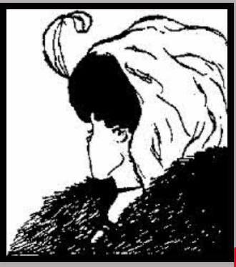
Do you see an old or young woman?

Slide 2
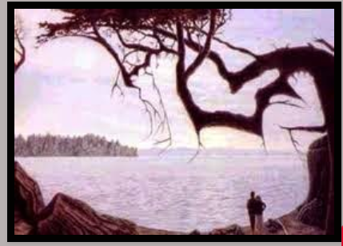
Do you see a landscape or a baby?

Slide 3
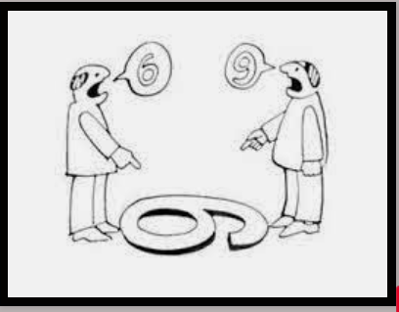
Which one is right?

Slide 4
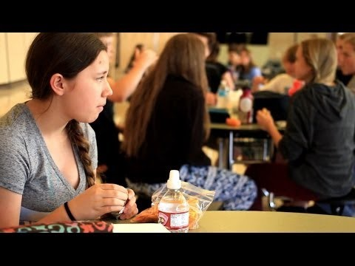

Slide 5
Agree, Disagree, not sure
Scenario:
During lunch period a girl is making her way through the lunch line when a classmate approaches to ask if she can cut in front of her place in line. The girl replies no, saying that it isn’t fair to the people behind her. Annoyed, the other girl shoves her forcefully and takes her place in the line.
Action:
Seeing this, you decide to tell a teacher

Slide 6
Agree, Disagree, not sure
Scenario:
Your friend is being mistreated on the bus. Every day she sits beside you, and another girl bothers her by pulling her hair, making mean comments about her outfits and saying rude things about her mother. Your friend tries to ignore the taunts, but often she ends up crying.
Action:
One day you decide to take matters into your own hands, and when the girl starts to bother your friend, you turn around and tell her to cut it out or else you’re going to tell the bus driver.

Slide 7
Agree, Disagree, not sure
Scenario: You learn that some of your schoolmates have created an exclusive list naming the “cute kids” in your grade. The list also includes comments like “Why is so-and-so on there? We all know that he’s ugly.”
Action:
Even though you haven’t seen the list for yourself, you decide to tell your teacher that you’ve heard it exists.

