Slide 1
The Smarter Balanced Assessment Consortium
Getting Started in the Digital Library
Notes:
Welcome to the Getting Started Tutorial. The following information will be helpful as you get started using the Digital Library.

Slide 2
Topics
How do I login to the Digital Library for the first time? (slides 3 – 5)
How do I create my own Password? (slides 6 – 12)
How do I complete my Personal Profile? (slides 13 – 22)
How do I edit my Personal Profile? (slides 24 – 31)
Notes:
The topics for Getting Started in the Digital Library include:
How do I login to the Digital Library for the first time?
How do I create my own password?
How do I complete my personal profile?
How do I edit my personal profile?

Slide 3
Topics
How do I login to the Digital Library for the first time?
How do I create my own Password?
How do I complete my Personal Profile?
How do I edit my Personal Profile?
Notes:
Let’s start by reviewing how you will login to the Digital Library for the first time.

Slide 4
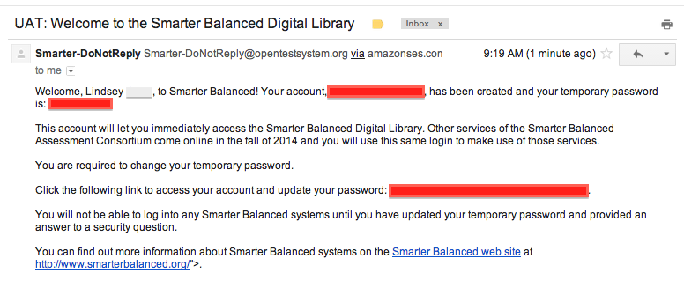
Email
Notes:
If you are a new user, you will receive an activation email containing your user name, temporary password, and a link to the Digital Library. Click on the link.

Slide 5
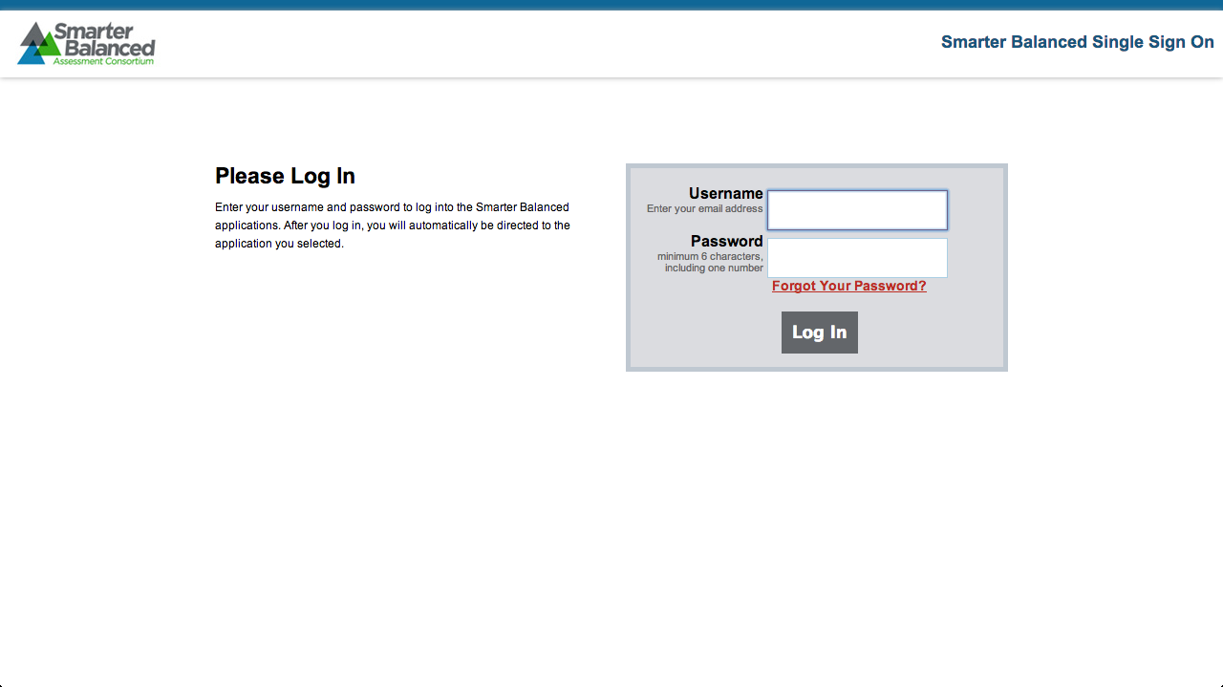
Smarter Balanced Single Sign On
Notes:
Once you click on the link in the activation email, you will be taken to the Smarter Balanced Single Sign On login page as shown. Enter the username and temporary password provided in the email and click Log In to continue.

Slide 6
Topics
How do I login to the Digital Library for the first time?
How do I create my own Password?
How do I complete my Personal Profile?
How do I edit my Personal Profile?
Notes:
Let’s review how to create your own password.

Slide 7
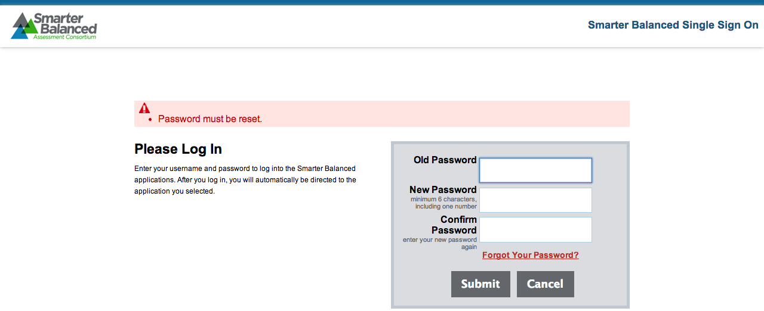
How do I create my own password?
Notes:
If you are a new user logging in for the first time, you will automatically be asked to create a new password.

Slide 8
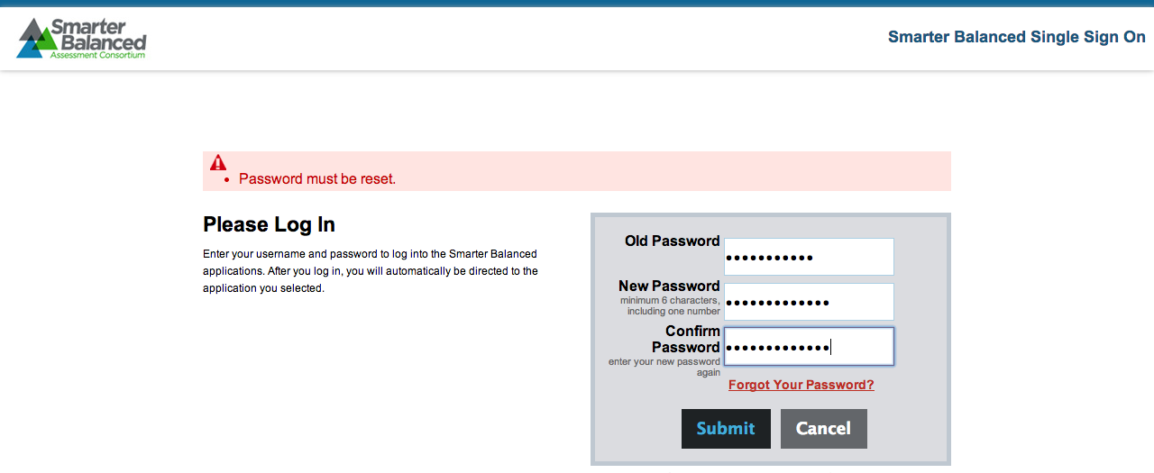
How do I create my own password?
Notes:
Enter your temporary password in the Old Password field. Type in a new password in the New Password field. Confirm your new password by retyping your new password in the Confirm Password field. Click Submit.

Slide 9
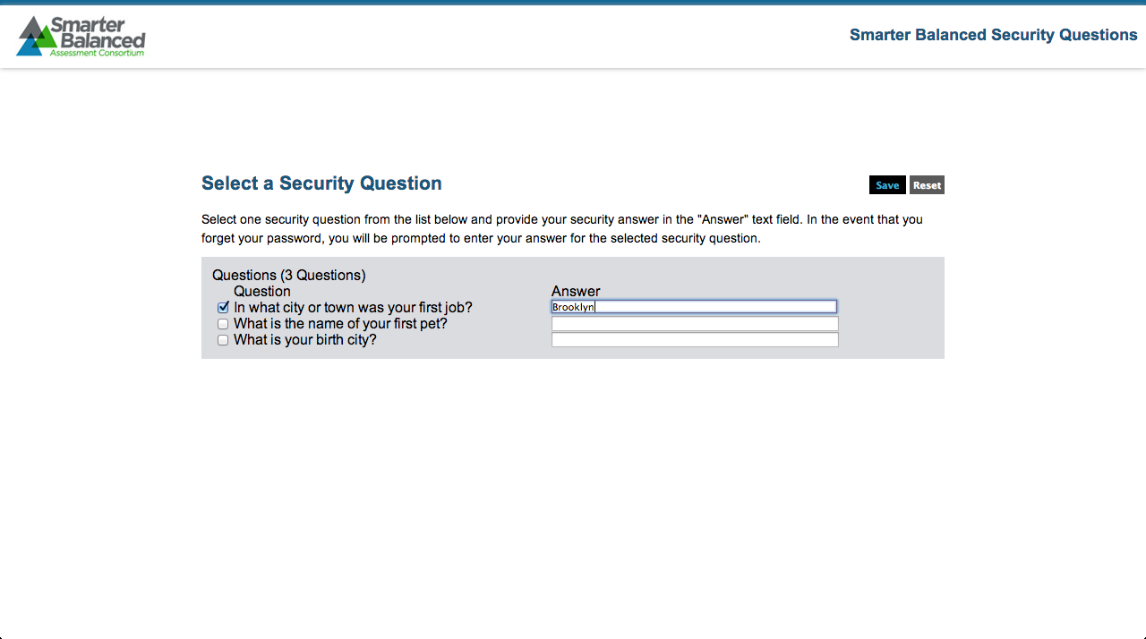
Security Question
Notes:
You will be asked to select one of three security questions. Select one and type your answer in the text box opposite the question. Click Save.

Slide 10
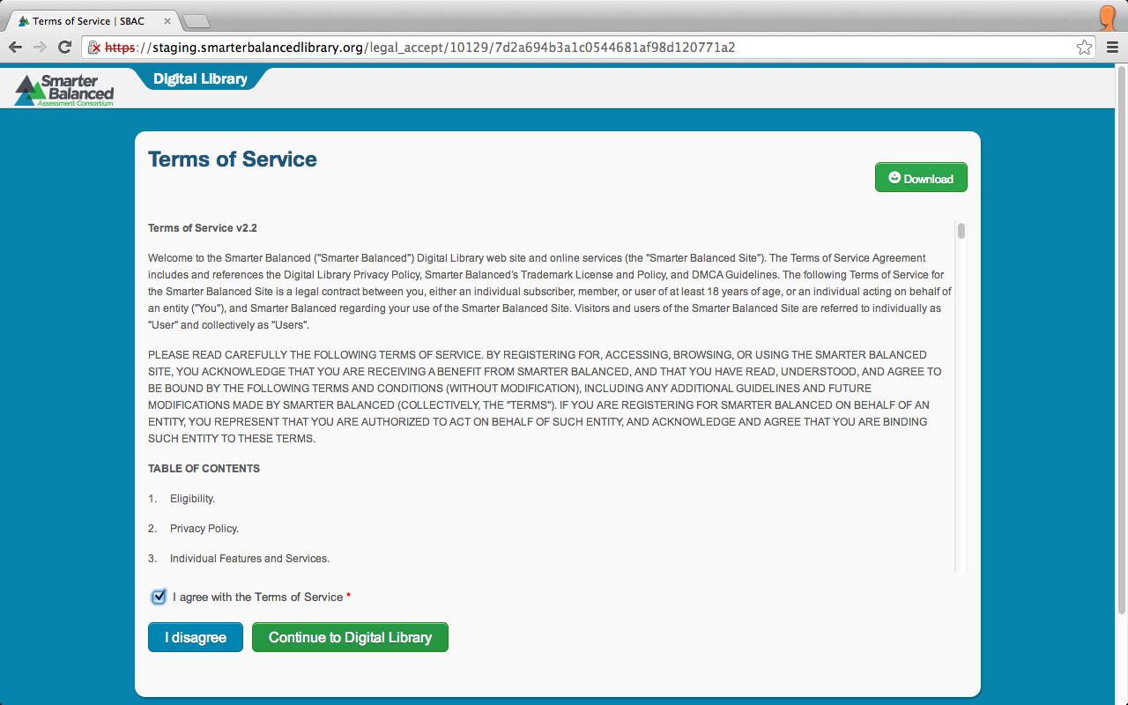
Terms of Service
Notes:
After you login, you are first presented with the Terms of Service page. Read the Terms of Service. Indicate that you agree with the Terms of Service and click Continue to the Digital Library.

Slide 11
Forgot Your Password?
Notes:
If, at any time, you forget your password or wish to change your password, navigate to the Smarter Balanced Single Sign On page.
Click Forgot Your Password.

Slide 12
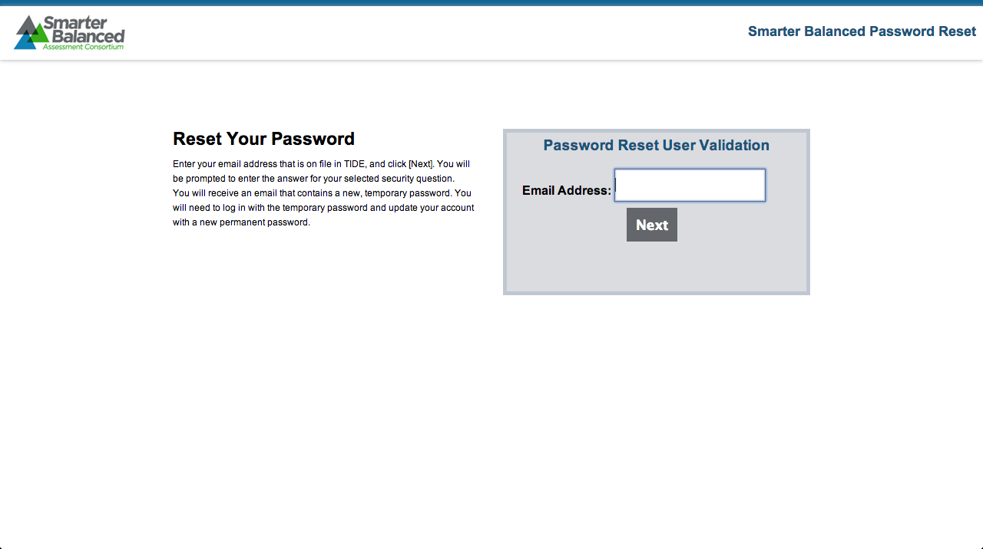
Reset Your Password
Notes:
Enter your email address that is on file, and click Next. You will be prompted to enter the answer for your selected security question. You will receive an email that contains a new, temporary password. You will need to login with the temporary password and update your account with a new permanent password.

Slide 13
Topics
How do I login to the Digital Library for the first time?
How do I create my own Password?
How do I complete my Personal Profile?
How do I edit my Personal Profile?
Notes:
We will now review how to complete your Personal Profile.

Slide 14
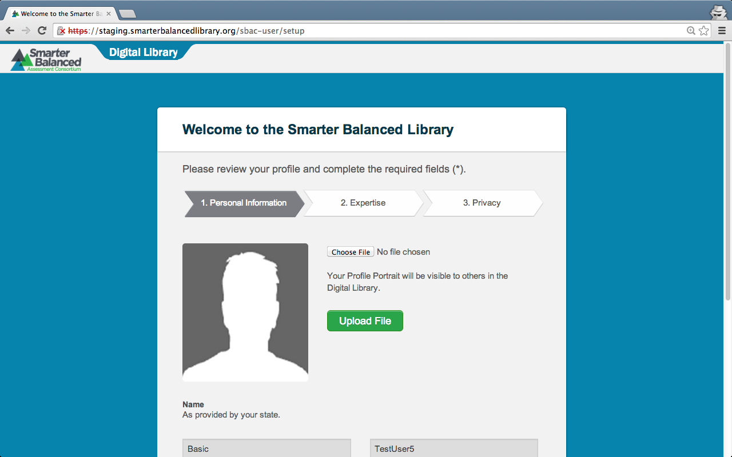
Personal Profile
Notes:
After completing the login process for the first time, you will be asked to complete your Personal Profile.
As a new user, you will automatically be directed to this page the first time you log in.
This is where you provide information about yourself and decide what information will be visible to other users of the Digital Library.
There are three sections you will need to complete: Personal Information, Expertise, and Privacy.
You are required to complete every section, tab, and field with a red asterisk. Other fields can completed at any time.
Let’s begin with the Personal Information section.

Slide 15
Personal Information
Notes:
This is the Personal Information section where you will add information about your self.
Here you have the option of uploading a profile picture. Click Upload File and select an image from your computer.

Slide 16
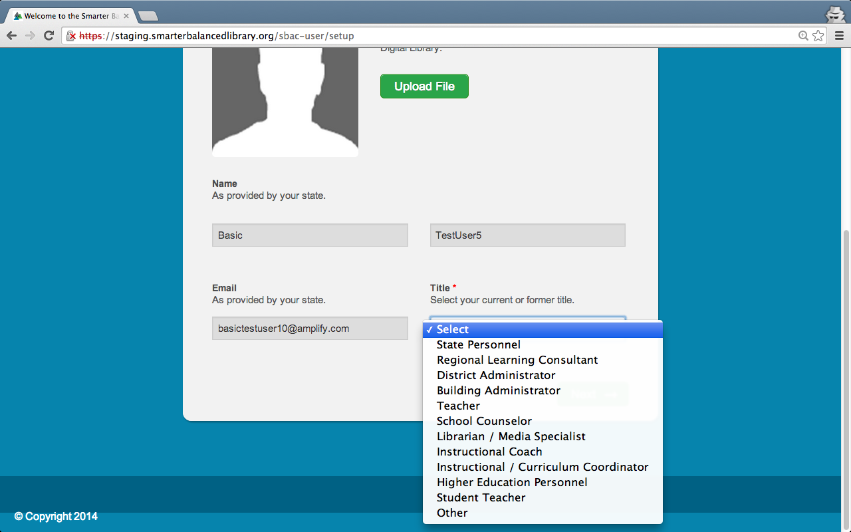
Personal Information
Notes:
In the Personal Information section, you will enter your first name and last name, and then select your title from the drop-down menu.

Slide 17
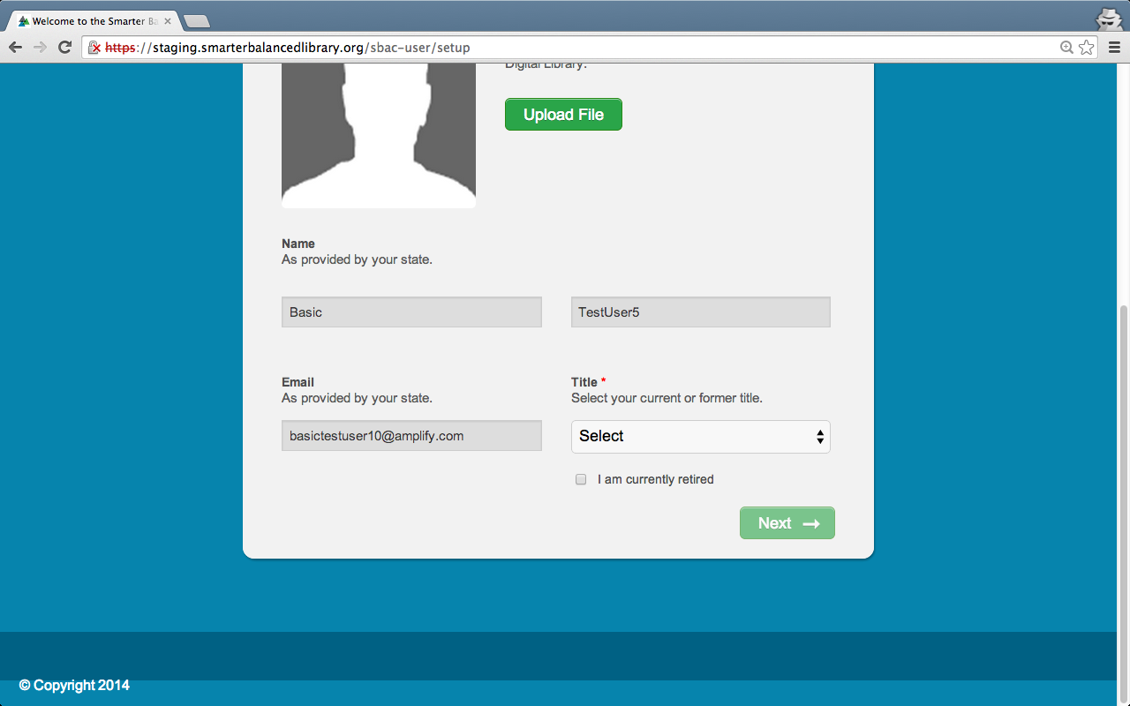
Personal Information
Notes:
Click the green Next → button at the bottom right side of the screen to go to the Expertise section.

Slide 18
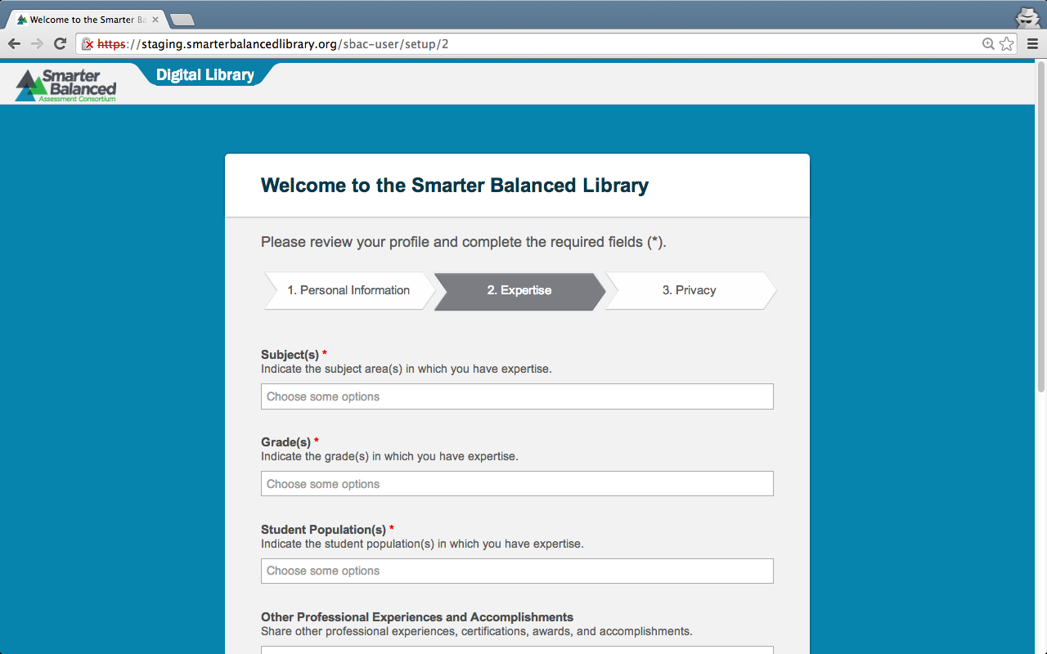
Expertise
Notes:
This is the Expertise section where you will add information about your professional background.

Slide 19
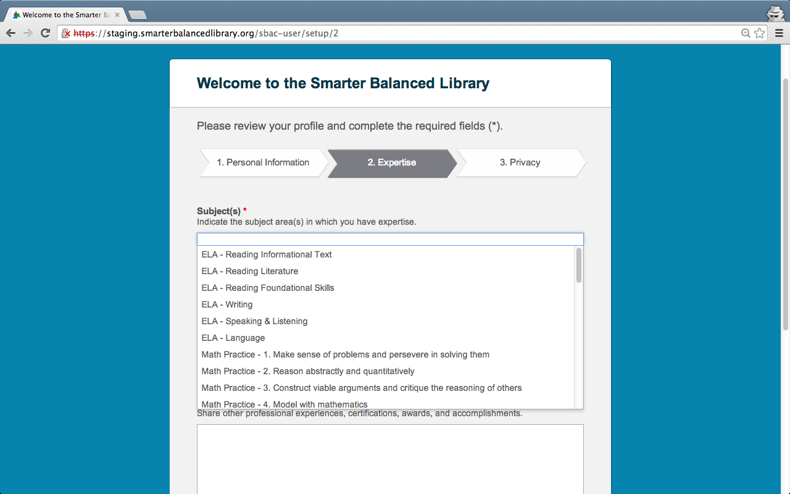
Expertise
Notes:
Select the appropriate subject(s), grade(s), and student population(s) that apply to you.
When you click in each box, a drop-down menu of choices will appear for each field. The Subjects field is shown as an example.

Slide 20
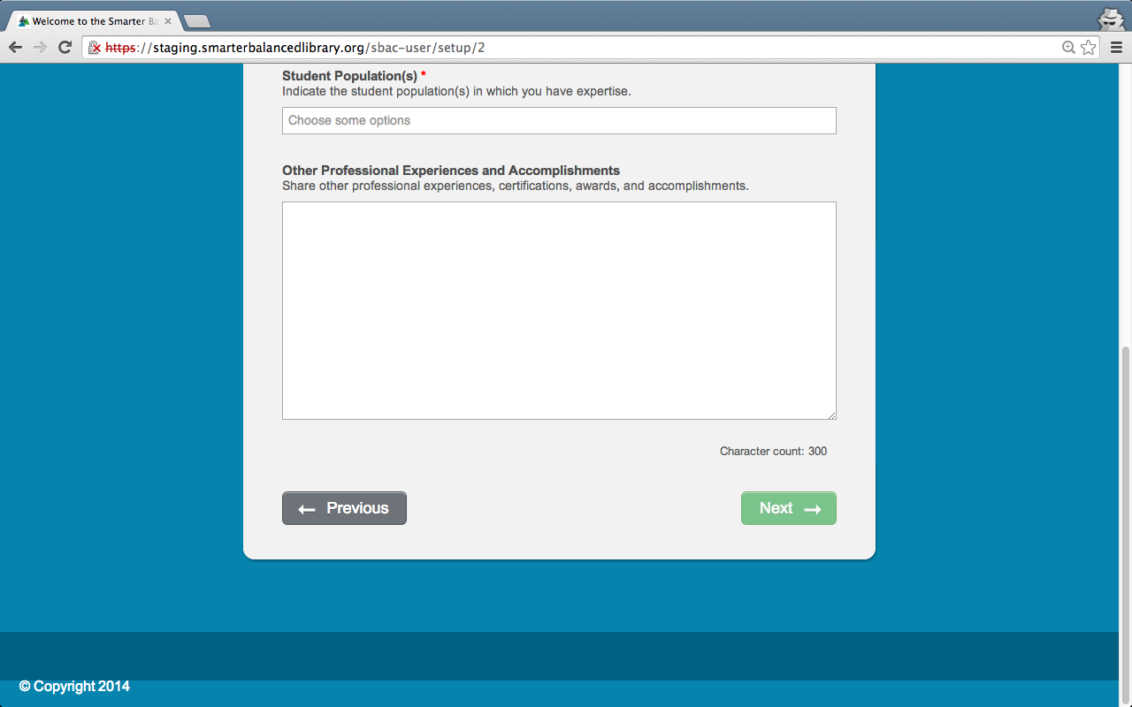
Expertise
Notes:
Click the green Next → button at the bottom right side of the screen to go to the Privacy section.

Slide 21
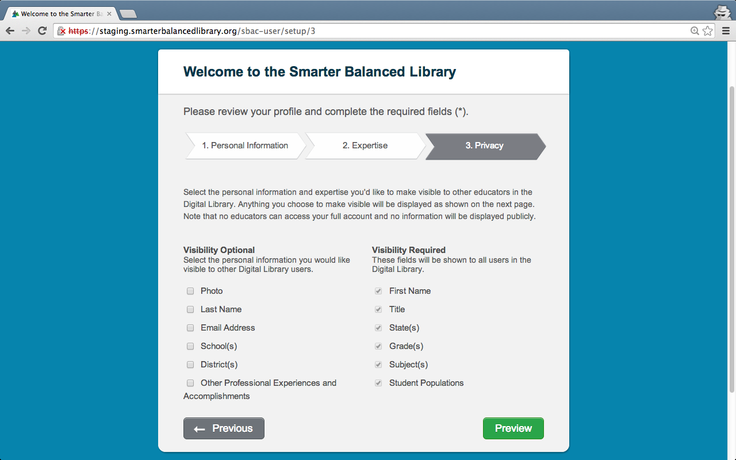
Privacy
Notes:
This is the Privacy section where you can adjust your visibility options.
Select the personal information you would like to make visible to other users of the Digital Library by checking the boxes.
Please note that users cannot access your full account and no information will be displayed publicly outside of the Digital Library.
Click the Preview button on the bottom right side of the screen to preview your profile.

Slide 22
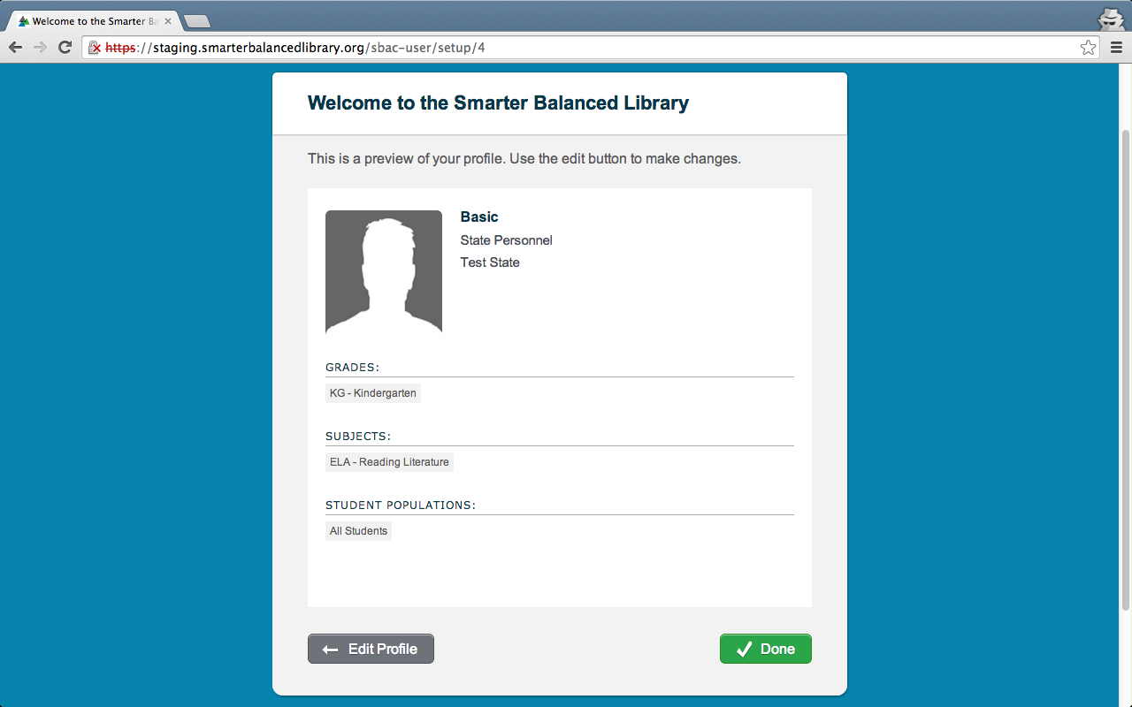
Preview
Notes:
This is a preview of your profile. You may click ← Edit Profile to go back and edit any section of your profile. You may click Done to complete your profile.

Slide 23
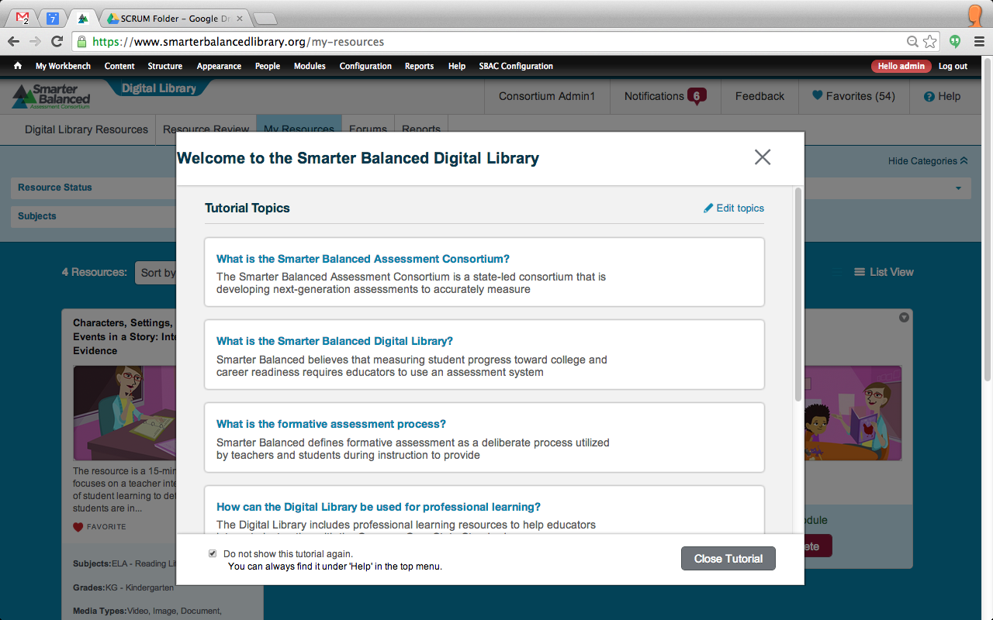
Welcome Tutorial
Notes:
After approving the preview of your Account information, you will be taken to the Digital Library Welcome Tutorial. You may view the Welcome Tutorial, which is optional, by clicking on the questions in blue text. Click Close Tutorial to continue to the Digital Library.

Slide 24
Topics
How do I login to the Digital Library for the first time?
How do I create my own Password?
How do I complete my Personal Profile?
How do I edit my Personal Profile?
Notes:
We will now review how to edit your Personal Profile.

Slide 25
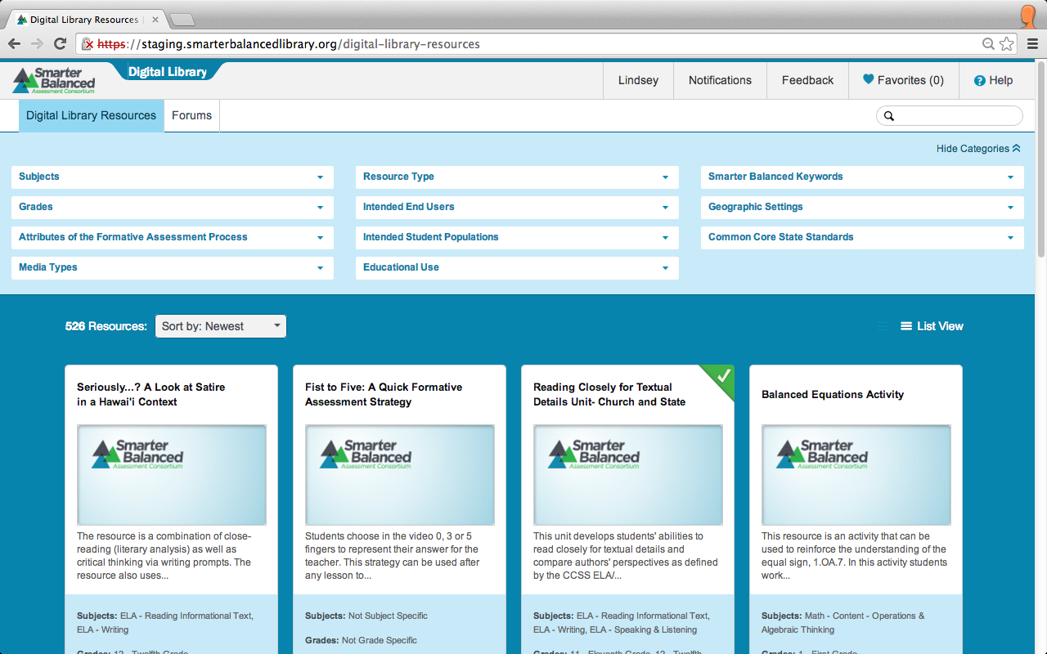
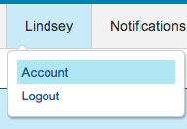
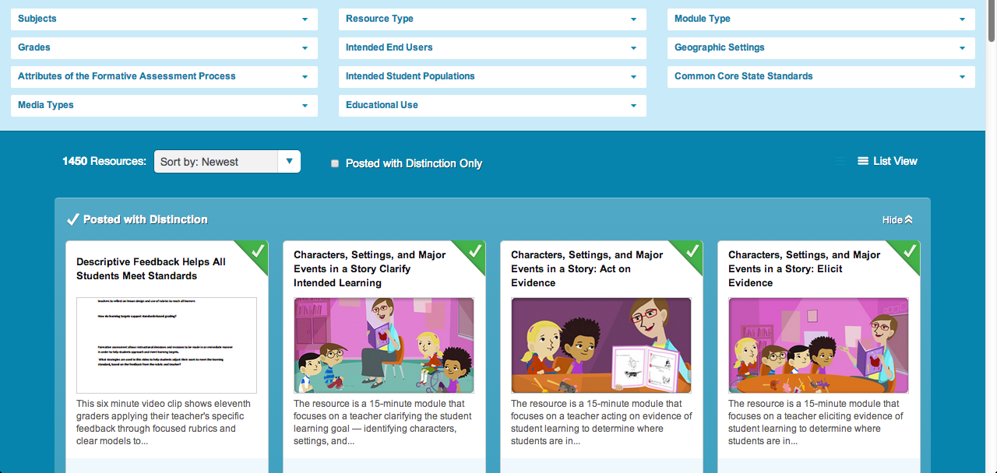
Personal Profile
Notes:
You can return to your Personal Profile page from anywhere in the Digital Library by clicking on your name in the header on the top right of the page and selecting Account.

Slide 26
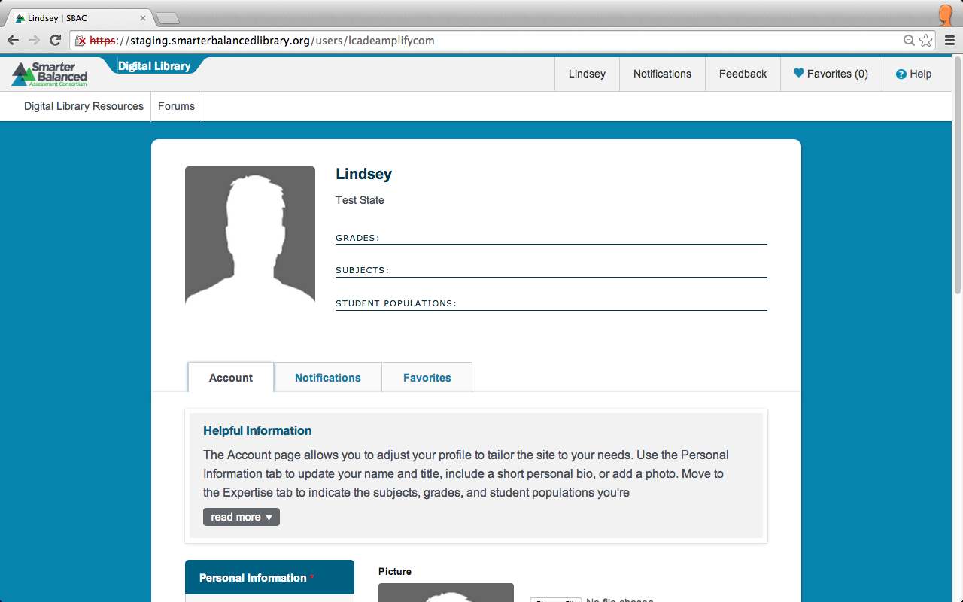
Personal Profile Edits
Notes:
This is the Personal Profile page.
This is where you provide information about yourself and decide what information will be visible to other users of the Digital Library.
There are three tabs on your Personal Profile Page: Account, Notifications, and Favorites. Be sure to review the Helpful Information below the tabs. Click read more to view more.
You are required to complete every section, tab, and field with a red asterisk.

Slide 27
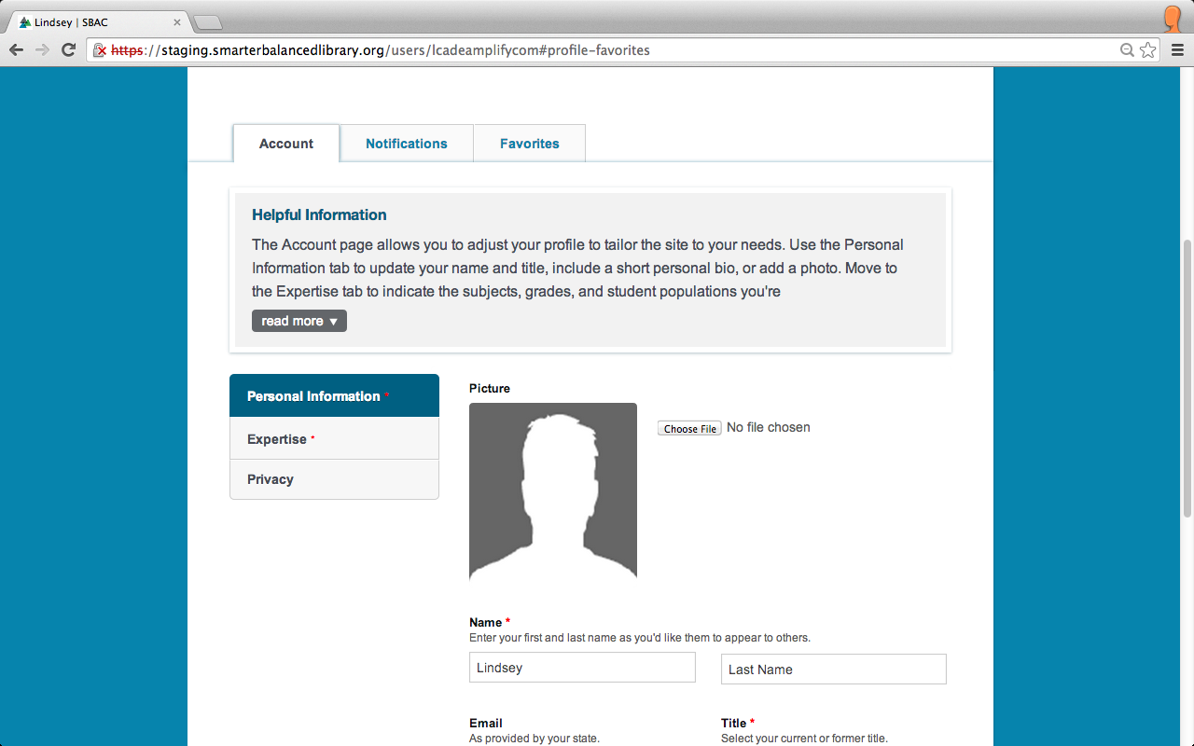
Personal Profile Edits
Notes:
Let’s first look at the Account tab.
The first section is Personal Information.

Slide 28
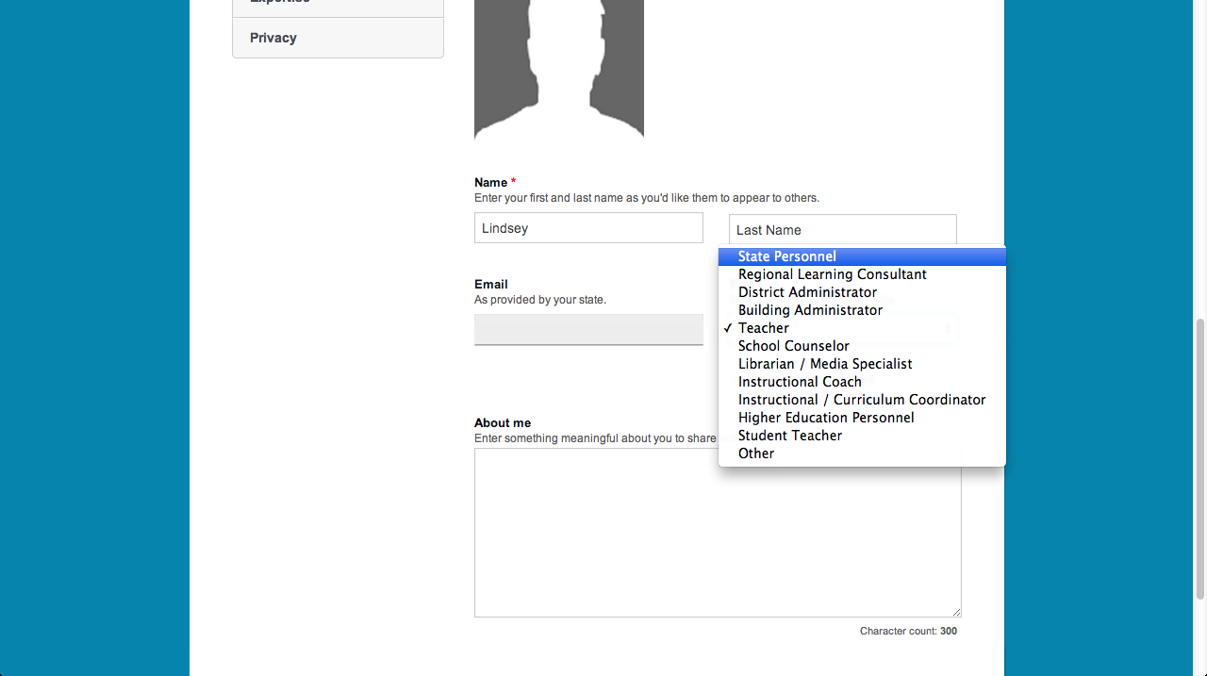
Personal Profile Edits
Notes:
On the Personal Information page, you will enter your first name and last name, and then select your title from the drop-down menu.
You will also have the option of uploading a profile picture and adding your background information in the About me section.
There is a green Save Changes button at the bottom right side of the screen. Click this button to save your personal information before moving to the next tab.

Slide 29
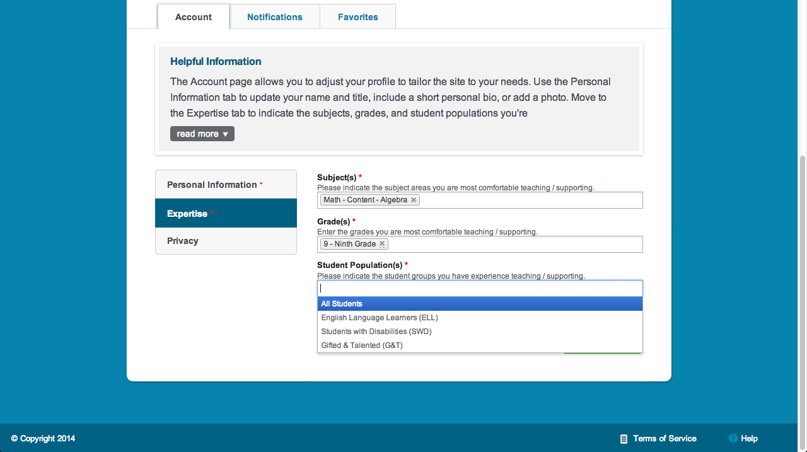
Personal Profile Edits
Notes:
After entering personal information, click the Expertise tab on the left side of the screen to add information about your professional background.
Select the appropriate subject(s), grade(s), and student population(s) that apply to you.
When you click in each box, a drop-down menu of choices will appear for each field. The Student Population(s) field is shown as an example.
This tab also has a green Save Changes button at the bottom right side of the screen. Click this button to save information on your expertise.

Slide 30
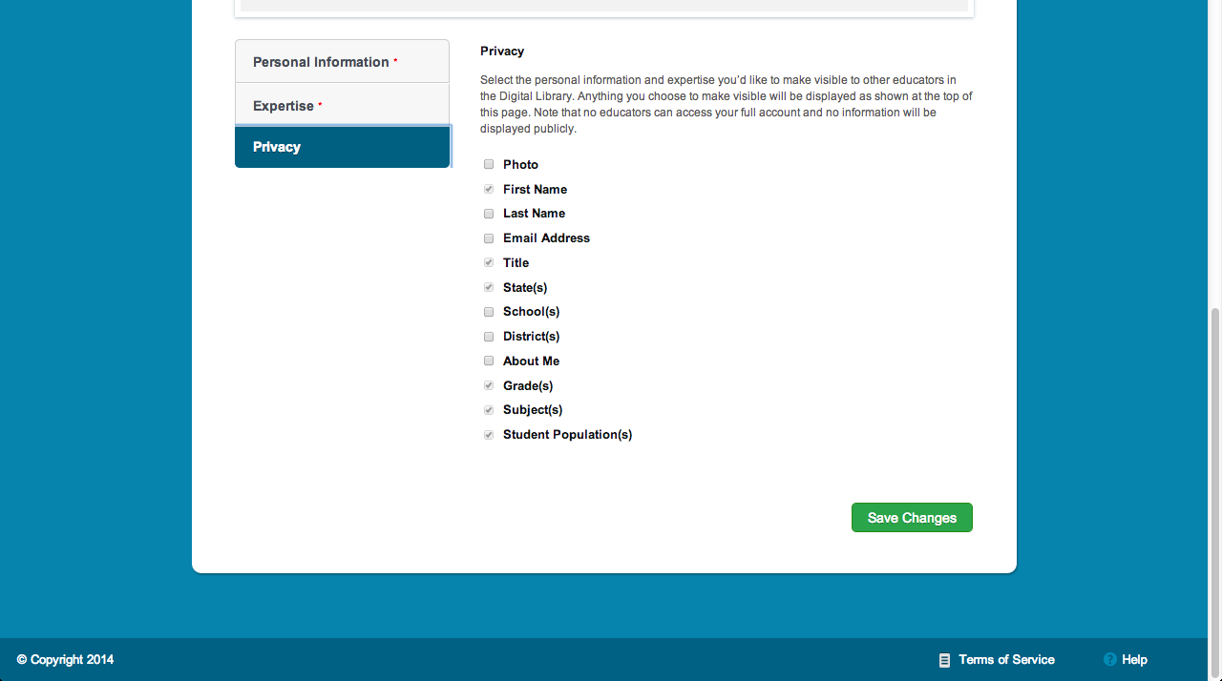
Personal Profile Edits
Notes:
After entering your expertise, click the Privacy tab on the left side.
Select the personal information you would like to make visible to other users of the Digital Library by checking the boxes.
Please note that users cannot access your full account and no information will be displayed publicly outside of the Digital Library.
Click the Save Changes button on the bottom right side of the screen to save your privacy choices.

Slide 31
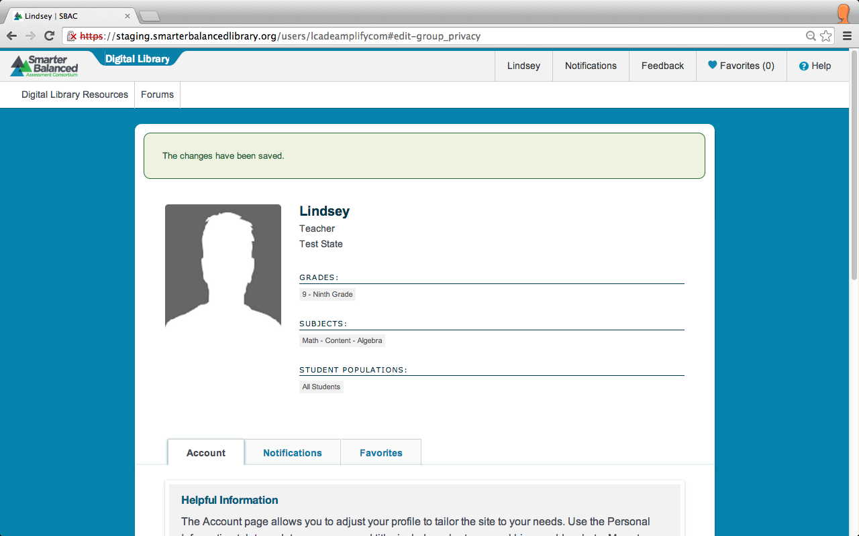
Personal Profile Edits
Notes:
After clicking the Save Changes button, you will receive a confirmation that your changes were saved.

