Slide 1
Inversions:
Directly improves lymphatic flow which pick up toxins and bacteria to be eliminated by lymph nodes. Lymph moves as a result of muscle contraction (calves, quads, hams) and gravity.
Improves blood flow to brain—get out of your slump, and increase your energy.
Relax– inversions like legs up have a relaxing effect targeting the parasympathetic system.
Core strength---inversions require upper body strength to hold and maintain

Slide 2
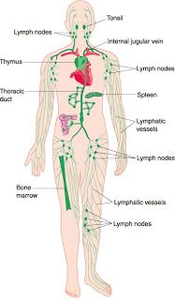
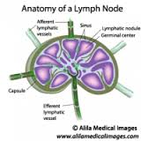
Lymphatics-covert defense. lymph nodes- miniature grenades

Slide 3
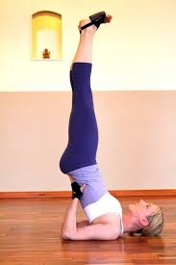
Candlestick

Slide 4
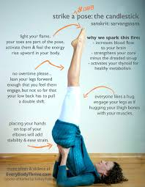

Slide 5
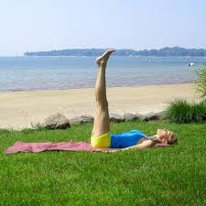

Slide 6
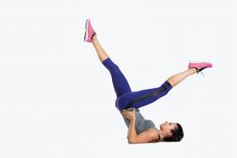
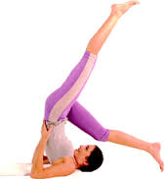

Slide 7
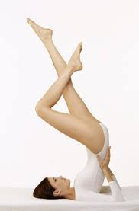

Slide 8
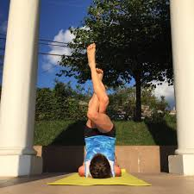

Slide 9
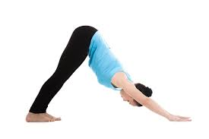
Downward facing dog

Slide 10
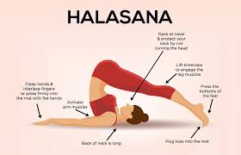
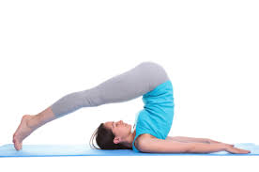
Plow pose--Halasana

Slide 11
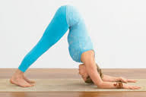
Dolphin –heels off mat; upper body resting on forearms

Slide 12
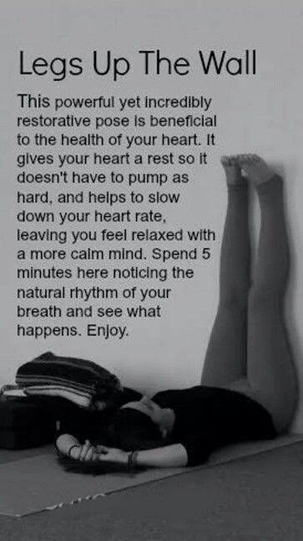

Slide 13
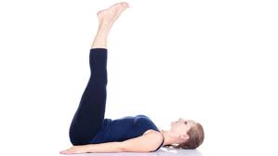
Legs up the wall—Viparita Karani

Slide 14
Inversion and salutation flow
MOUNTAIN
CHAIR CANDLESTICK SPLIT
STANDING FORWARD FOLD UPDOG
DOLPHIN CAT/COW
CRESCENT LUNGE CRESCENT
UPDOG ½ STAND FORWARD FOLD
ROLL OVER INTO CANDLESTICK CHAIR
PLOW MOUNTAIN
BRIDGE
SUPINE BUTTERFLY
RECLINING TWIST

