Slide 1
bACKBENDS
THESE MOVEMENTS ARE STRENGTHENING POSES FOR LARGE PRIMARY MOVERS AND SMALLER SECONDARY MOVERS. Help stabilize core and reduce back pain

Slide 4
Cobra vs. upward dog

Slide 5
Sphinx pose

Slide 6
locust

Slide 7
Half frog pose

Slide 8
Bow pose

Slide 9
Bridge pose

Slide 10
Upward bow (wheel)

Slide 11
Side bow lying or on knee

Slide 12
Cross bow

Slide 13
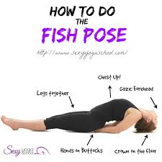
Fish pose

Slide 14
Wild thing

Slide 15
Standing backbend

Slide 16
camel

