Slide 1
kinesiology
Axial and appendicular skeleton

Slide 2
Flexion
Two body surfaces coming closer together
Occurs at neck, shoulders, elbows, core, knees, toes:
Neck flexion(chin to chest)
Shoulder flexion: arm moves straight overhead at shoulder joint
Global flexion: folding forward as in standing forward fold
Hip flexion
Leg flexion: bring heel to glute
Toe flexion: curl toes
Finger flexion: curl fingers
Wrist flexion

Slide 3
Extension
Two surfaces moving away from one another:
Occurs at all the same joints as flexion:
Neck extension: lifting head up from chin to neutral
Shoulder extension: straight arm coming back down and behind body
Global extension: standing back up from forward fold to neutral
Hip extension
Leg extension: leg kicks forward as in a soccer kick
Fingers/toes: sticking out straight
Wrist extension

Slide 4
Hyperextension
This movement occurs at neck, core, and joints during injury.
Neck: dropping head back behind frontal plane
Global hyperextnsion: standing backbend

Slide 5
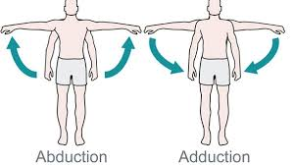
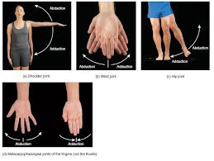
Abduction: movement of limbs away from midline of body.
Arms
Legs
Fingers
Toes
Adduction: Movement of body part toward the midline

Slide 6
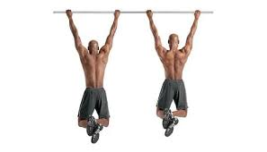
Scapular retraction: pulling shoulder blades posteriorly toward spine

Slide 7
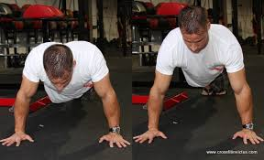
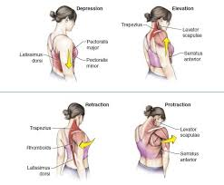
Scapular protraction: shoulder blades sliding atop ribcage anteriorly toward front body.

Slide 8
Scapular elevation and depression: elevation pulls shoulder blades upward toward ears; whereas depression pulls downward

Slide 9
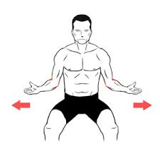
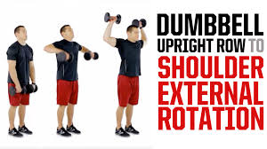
External rotation of shoulder: movement occurs at shoulder with forearm flex at 90 degrees

Slide 10
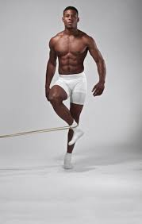
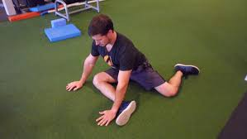
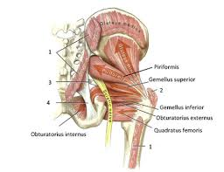
External rotation of hip: movement occurs at hip with leg in flexion.

Slide 11
Internal rotation of hip (at femur)

Slide 12
Cervical rotation

Slide 13
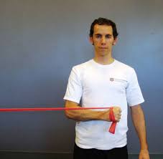
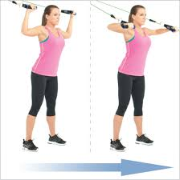
Internal rotation of shoulder

Slide 14
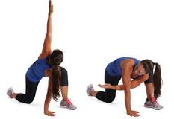
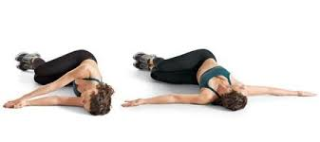
Thoracic Rotation

Slide 15
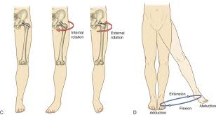
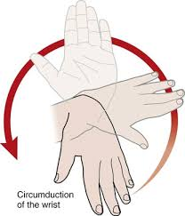
circumduction

Slide 16
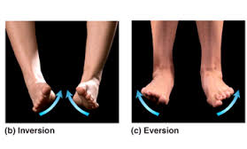
Inversion and eversion of foot

Slide 17
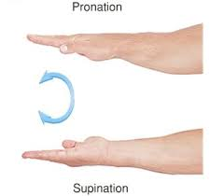
Supination, pronation, flexion, extension,radial & ulnar deviation

Slide 18
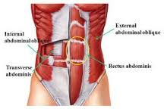
Core muscle actions: flexion, extension, and rotation

Slide 19
Transverse abdominus

Slide 20
Back—lats, erector spinae, glute max, trap

Slide 21
Major muscles of core:
Anterior muscles
Pelvic floor muscles posterior muscles
Transverse abdominus erector spinae
Internal/external obliques lats
Rectus abs (6-pack) gluteus max
TRAPS
Diaphragm (internal)

Slide 22
Core stability:
The name given to the strengthening of the corset of muscles surrounding back and abdomen. These muscles are our powerhouse muscles and provide a SOLID BASE upon which all other muscles can work upon to INITIATE movement.

Slide 26
Positions/movements strengthening and stretching back
Strengthen lengthen

Slide 27
Movements/positions strengthening/lengthening anterior
Strengthen lengthen

Slide 28
Positions/movements strengthening/lenghthening sides
Strengthen lengthen

