Slide 1
2024–25 FAFSA® Form Preview Presentation
July 2023

Slide 2
Topics
Overview
Dependent Student Invites Parent
Parent Starts and Submits a FAFSA® Form Without Student Consent or Signature
Independent Student Invites Student Spouse
Independent Student Who Is Single and a Non-Tax Filer
FAFSA Submission Summary
Dependent Student and Direct Unsubsidized Loan
Provisionally Independent Student

Slide 3
Overview (1 of 5)
The 2024–25 Free Application for Federal Student Aid (FAFSA®) Form Preview Presentation provides screenshots that financial aid professionals, mentors, and counselors can use as a guide for the 2024–25 online FAFSA form. The screenshots and information provided can be used to create and/or modify presentations for professional trainings and high school completion nights.
The screenshots are intended to show what the FAFSA form will look like and present a majority of the questions displayed on the FAFSA form. Note: Most applicants and/or parents are unlikely to need to answer all the questions when completing the form.
Some screenshots are currently unavailable. They will be available in a future preview presentation scheduled for December 2023.
The 2024–25 version of the FAFSA form will be available in December 2023.

Slide 4
Overview (2 of 5)
Major changes to the 2024–25 FAFSA® form include the following:
An FSA ID (account username and password) required to access the FAFSA form
Users without a Social Security number can create an FSA ID and access the FAFSA form
A roles-based FAFSA form
Roles = Student (Applicant), Parent, and Preparer
Once all required data has been provided and all sections have been signed, any role can submit the FAFSA form
Introduction of contributors to the FAFSA form
Contributors = Parent, Other Parent, Student Spouse, and Student (when invited by Parent or Preparer)
Contributors must provide the required information and sign their respective section for a FAFSA form to be considered complete
A FAFSA onboarding experience for both initial entry and correction entry

Slide 5
Overview (3 of 5)
Major changes to the 2024–25 FAFSA® form include the following:
Integration of the FAFSA form into StudentAid.gov’s Dashboard, Status Center, Notification Center, and Settings
The general look and feel of the FAFSA form
Integration to allow users’ federal tax information to be retrieved and transferred directly into the FAFSA form via IRS direct data exchange, replacing the IRS Data Retrieval Tool
Replacement of the Expected Family Contribution (EFC) with the Student Aid Index (SAI)
Required consent from users to
retrieve and disclose federal tax information,
be eligible for federal student aid, and
be eligible to receive an SAI.
Predictive search results for questions that require city, state, or school lookup

Slide 6
Overview (4 of 5)
The following are key features of the FAFSA® form on StudentAid.gov:
Students, parents, and preparers may begin, complete, and submit a new FAFSA form for the 2024–25 FAFSA processing cycle.
Dependent students must invite their parent(s) to contribute to their form if parent information is required.
Independent students and a dependent student's parent must invite their spouse to contribute to the student’s form if spouse information is required.
Students and contributors must provide consent to retrieve and disclose federal tax information from the IRS for the student to be eligible for federal student aid.

Slide 7
Overview (5 of 5)
The following are key features of the FAFSA® form on StudentAid.gov:
Students and parents may be eligible to transfer their FAFSA information into a state aid application. Participating states include Iowa, Minnesota, Mississippi, New York, Pennsylvania, New Jersey, and Vermont.
Students no longer need to take additional action to start a renewal FAFSA application.
After the FAFSA form is processed, students can correct or update their application. Contributors are able to correct or update only their sections of the student’s application.

Slide 8
Dependent Student Invites Parent

Slide 9
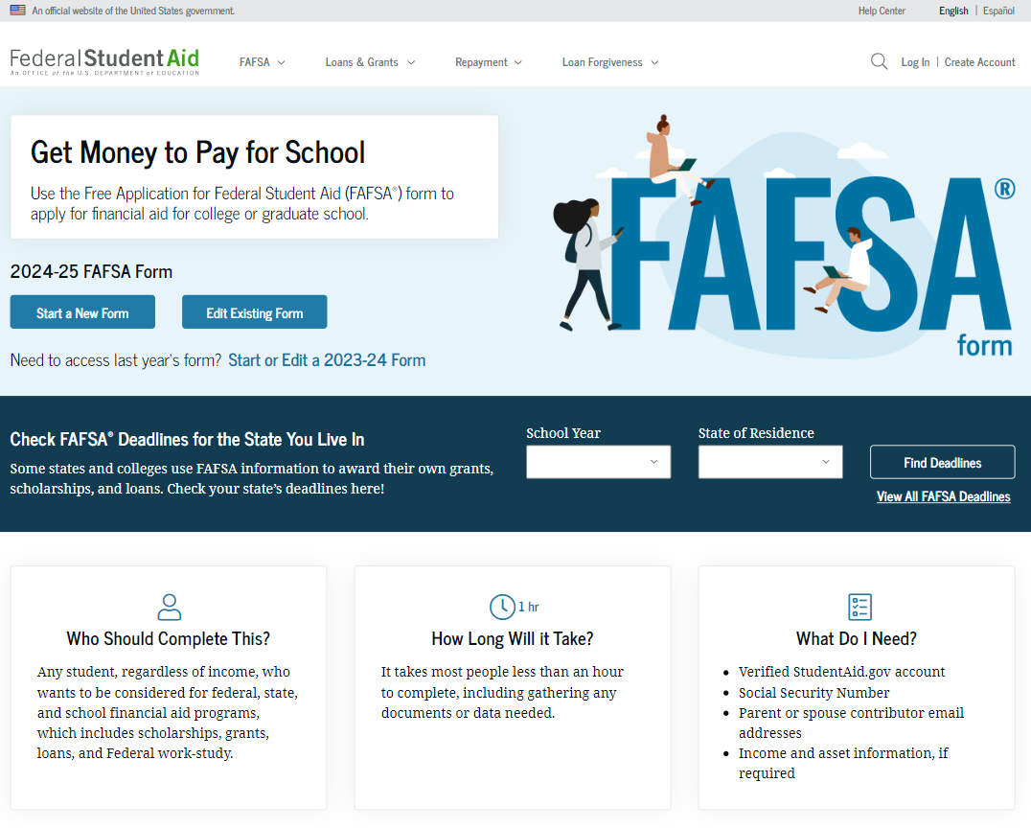
Dependent Student FAFSA® Form Landing Page
This is the main FAFSA® form landing page. On this page, students are directed to "Start a New Form" or "Edit Existing Form." For the purpose of this presentation, the student is beginning a new application.

Slide 10
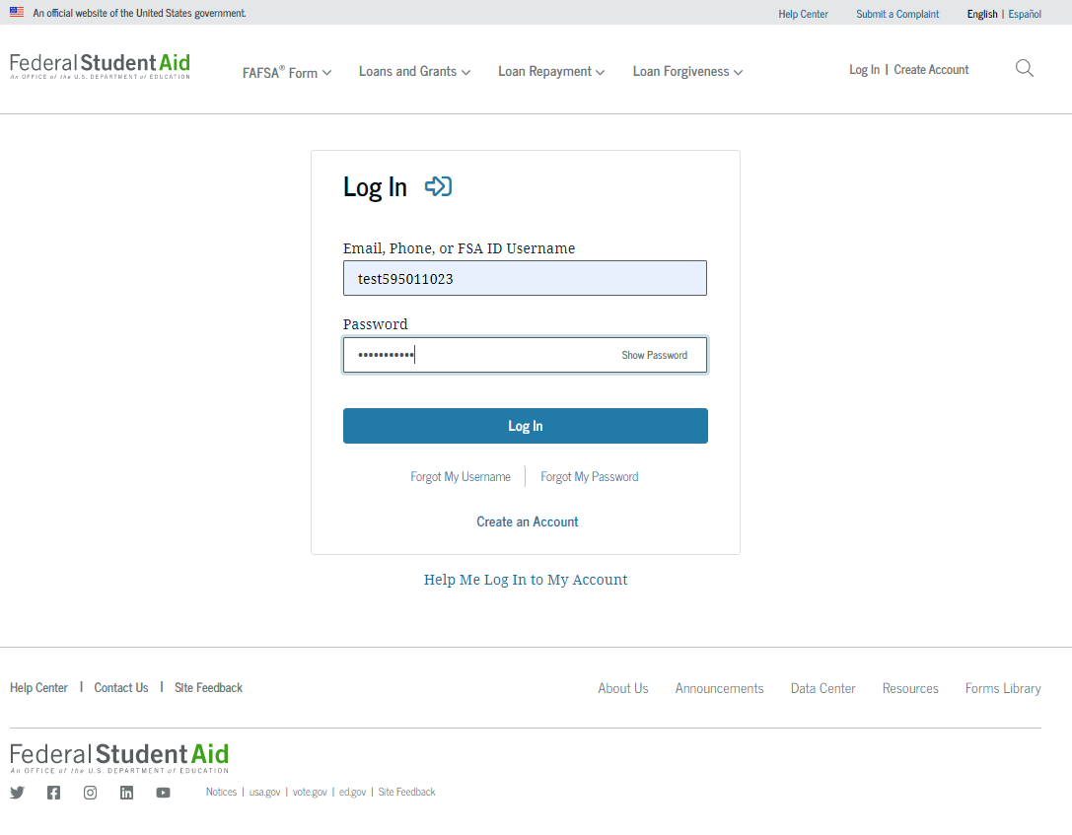
Dependent Student Log In
If the student selects "Start a New Form" from the FAFSA® landing page and they are not logged in to StudentAid.gov, they are taken to the “Log In” page to enter their log-in credentials. To access the FAFSA form, all students are required to have an FSA ID (account username and password). If the student doesn't have an FSA ID, they can select "Create an Account."

Slide 11
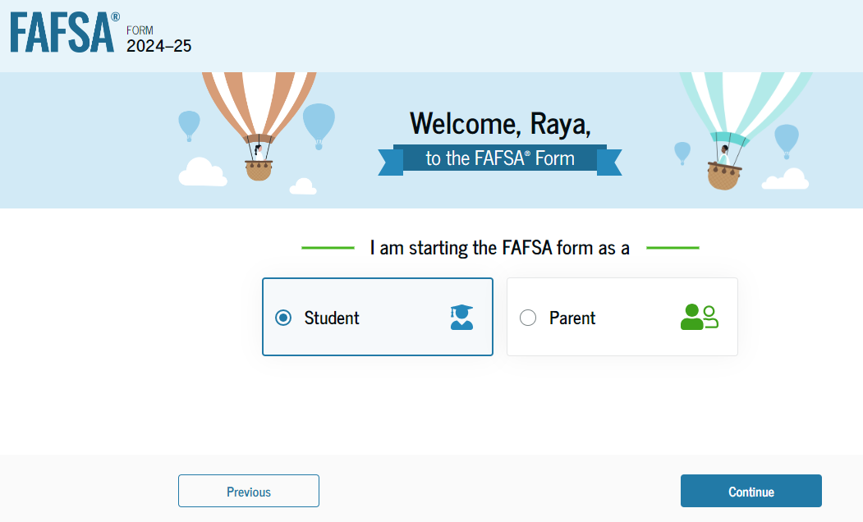
Dependent Student Roles
After logging in, the student can select the applicable role to fill out the FAFSA® form: “Student,“ or "Parent.“ The student selects “Student."

Slide 12
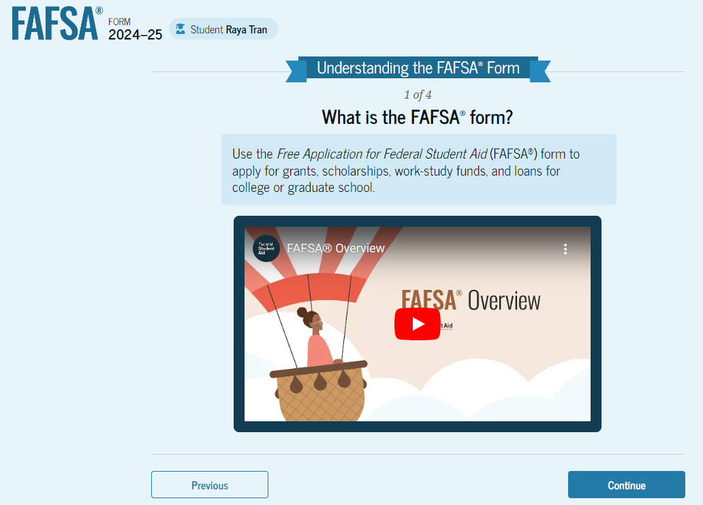
Student Onboarding (1 of 4)
When the student starts the 2024–25 FAFSA® form for the first time, they are taken through the FAFSA onboarding process. The first onboarding page provides an overview of the FAFSA form and an accompanying video.

Slide 13
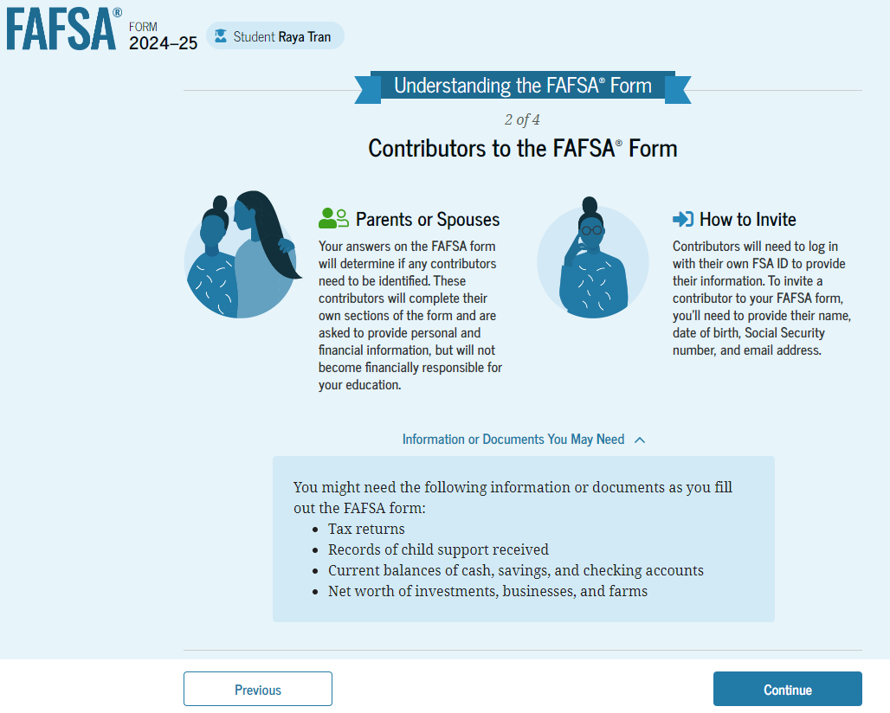
Dependent Student Onboarding (2 of 4)
The second FAFSA® onboarding page provides information about the different roles that may be required to participate in the student’s FAFSA form and documents that may be needed to fill out the form.

Slide 14
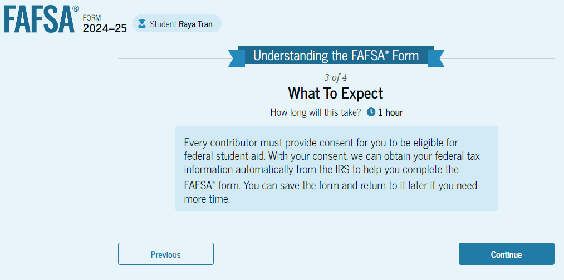
Dependent Student Onboarding (3 of 4)
The third FAFSA® onboarding page provides information about the types of questions the student can expect to see and how they can get additional help with filling out the FAFSA form.

Slide 15
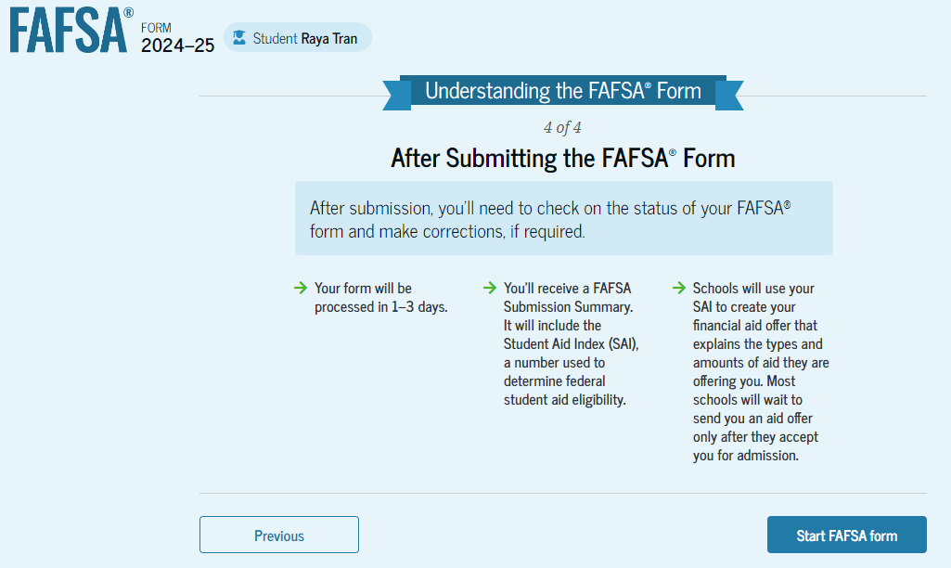
Dependent Student Onboarding (4 of 4)
The last FAFSA® onboarding page provides information about what to expect once the FAFSA form is completed and submitted. On this page, the student can select "Start the FAFSA form" to begin.

Slide 16
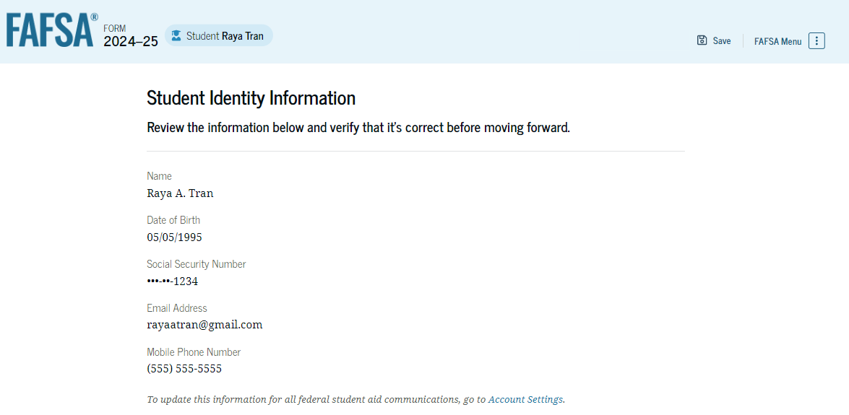
Dependent Student Identity Information
This is the first page within the student section. The student can verify that their personal information is correct. To update any of the personal information, the student must access their Account Settings on StudentAid.gov. For fields related to the student’s mailing address, the student can edit them directly on this page.

Slide 17
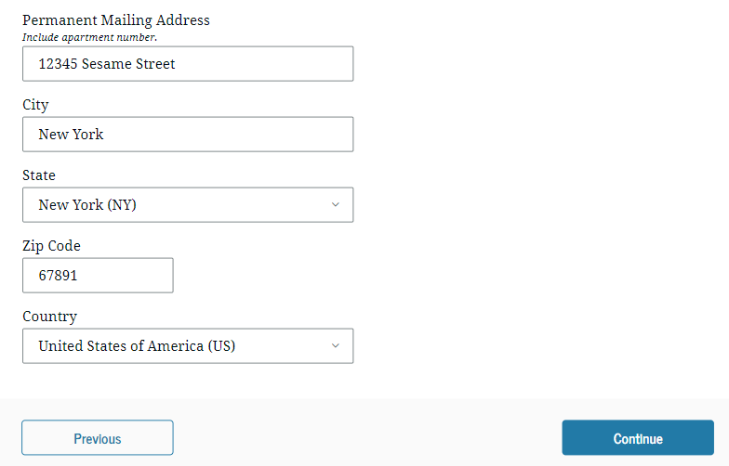
Dependent Student Identity Information (Continued)

Slide 18
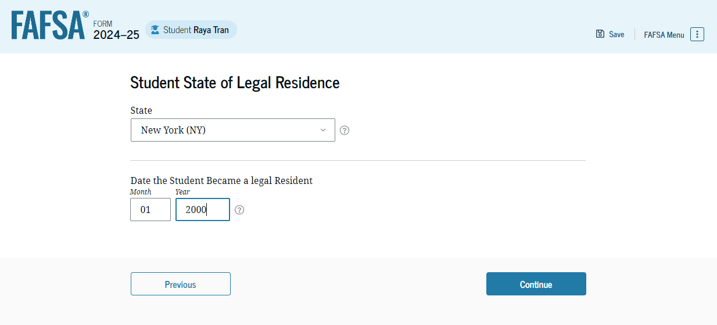
Dependent Student State of Legal Residence
The student is asked about their state of legal residence. The student selects the state from a dropdown box and provides the month and year when they became a legal resident.

Slide 19
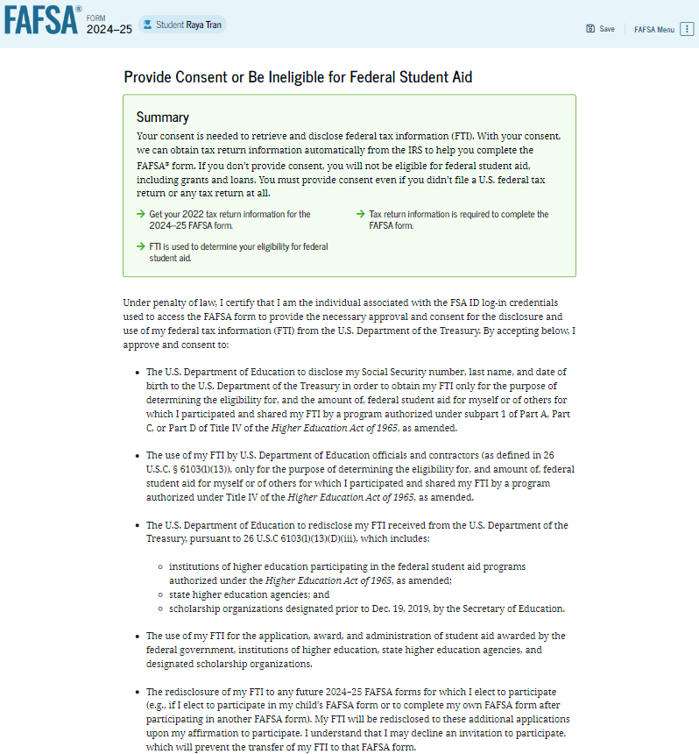
Dependent Student Provides Consent
This page informs the student about consent and their federal tax information. By providing consent, the student’s federal tax information is transferred directly into the FAFSA® form from the IRS to help complete the Student Financials section. The student selects "Approve" to provide consent and is taken to the next page.

Slide 20
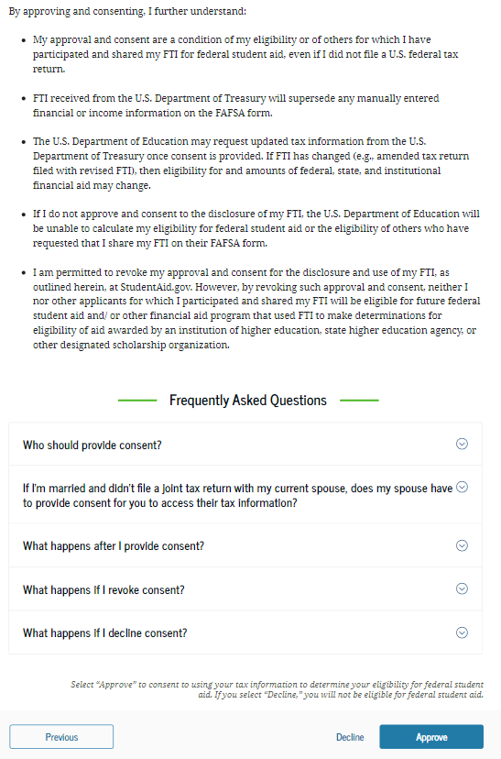
Dependent Student Provides Consent (Continued)

Slide 21
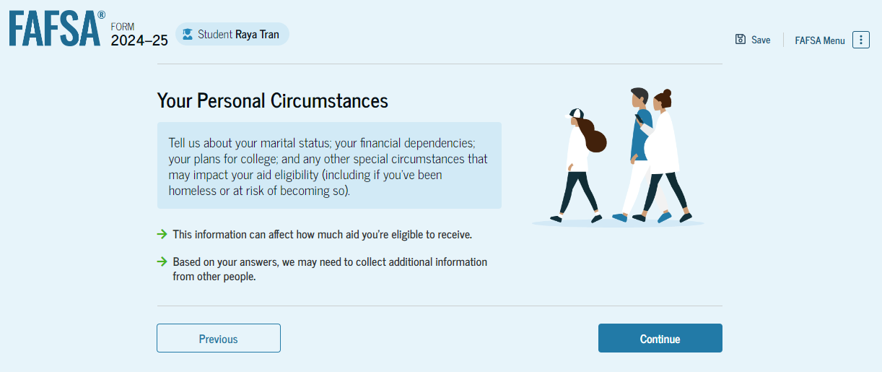
Introduction: Dependent Personal Circumstances
This is the first page within the Student Personal Circumstances section. It provides an overview of the section.

Slide 22
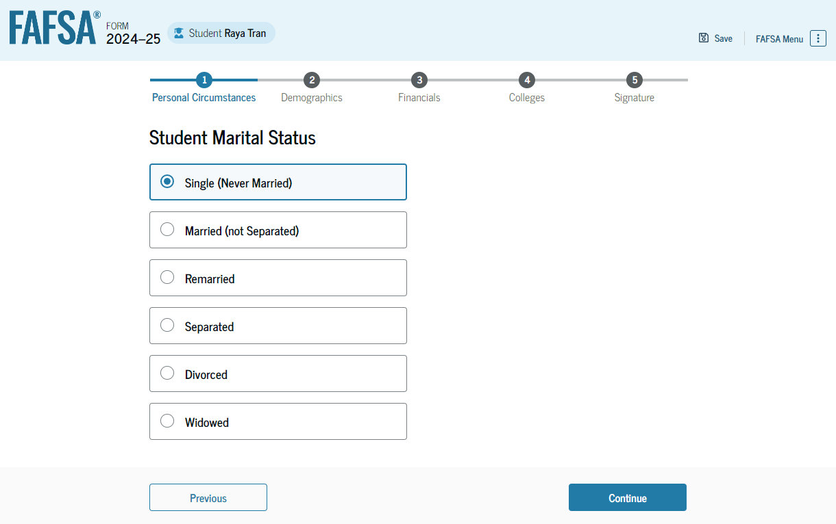
Dependent Student Marital Status
The student is asked about their marital status. The student selects the "Single (Never Married)" option.

Slide 23
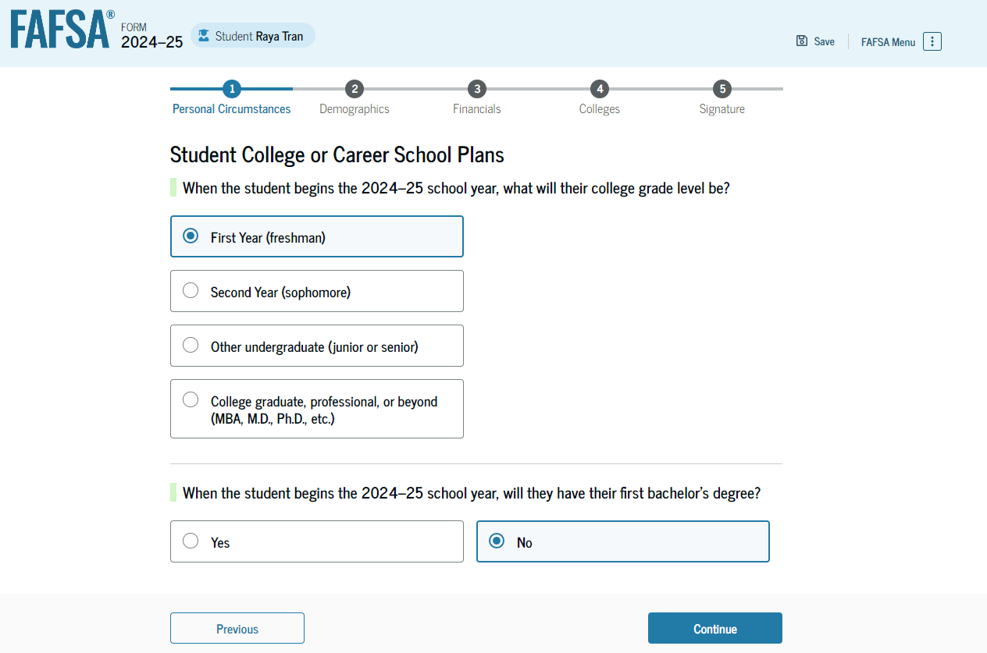
Dependent Student College or Career School Plans
The student is asked about their college grade level for the 2024–25 school year and if they will have their first bachelor’s degree. The student selects that they will be a "First Year (freshman)" and that they will not have their first bachelor’s degree.

Slide 24
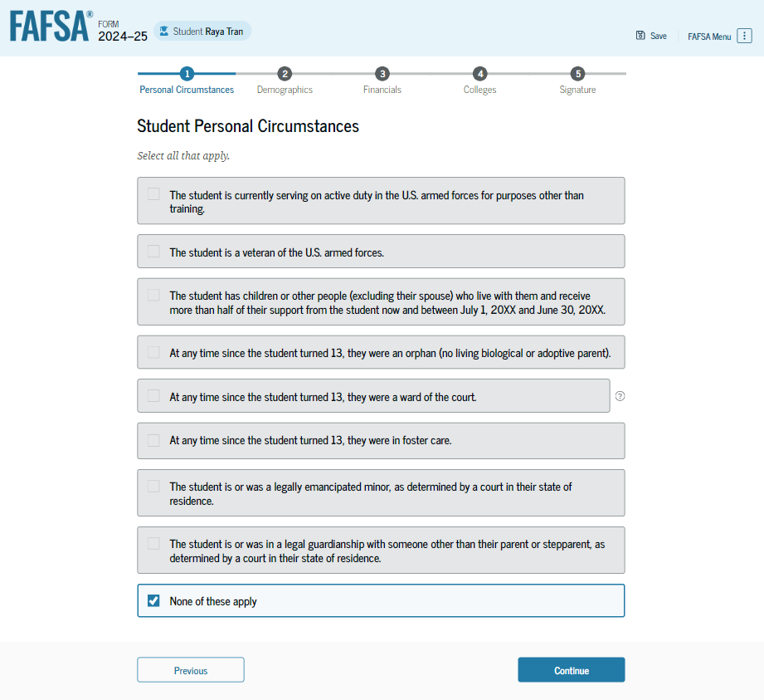
Dependent Student Personal Circumstances
The student is asked if any of the listed personal circumstances apply to them. The student selects the "None of these apply" option.

Slide 25
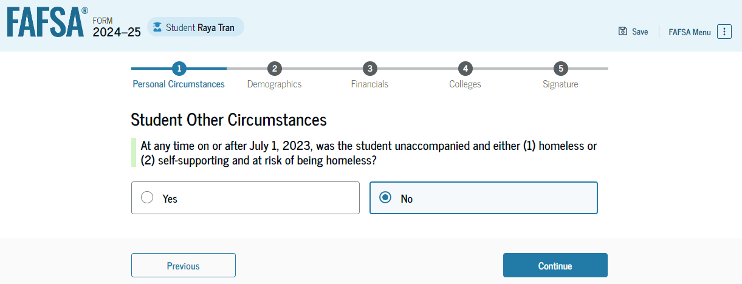
Dependent Student Other Circumstances
The student is asked if they were homeless or at risk of being homeless. The student selects "No."

Slide 26
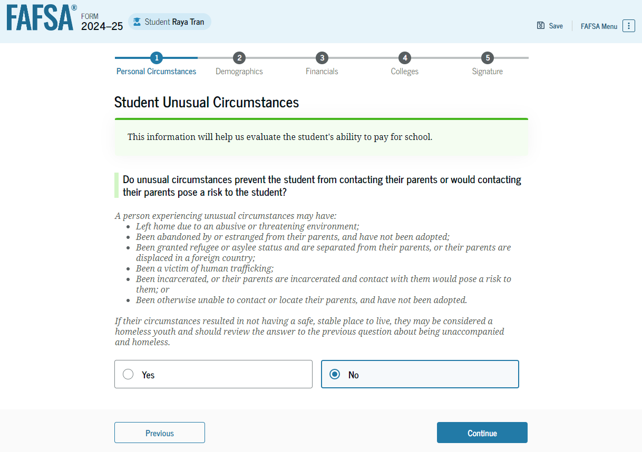
Dependent Student Unusual Circumstances
The student is asked if unusual circumstances prevent them from contacting their parent(s). The student selects "No."

Slide 27
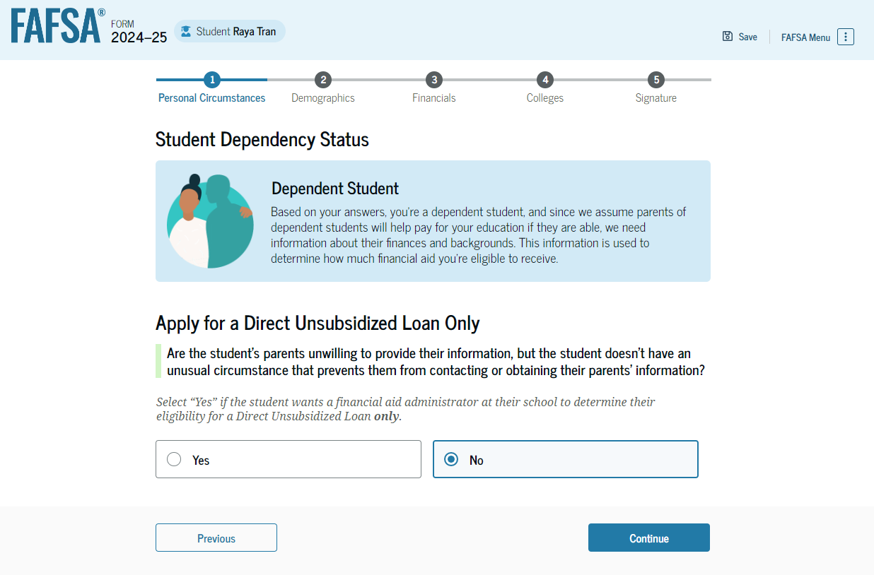
Student Dependency Status: Dependent Student
Based on the answers provided by the student, they are considered a dependent student. The student is asked if they want a financial aid administrator to determine their eligibility for a Direct Unsubsidized Loan only. This is an option if the student’s parents are unwilling to provide information. The student selects "No."

Slide 28
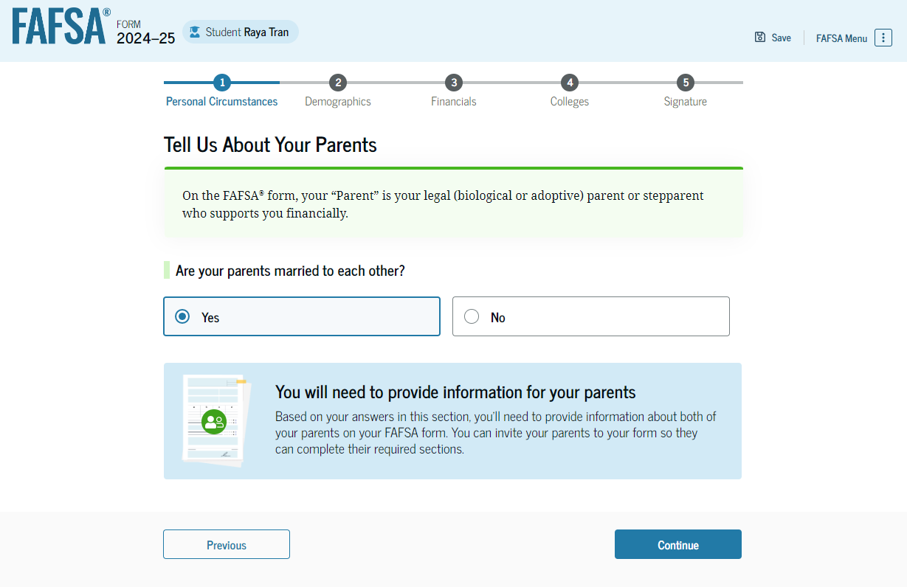
Dependent Student: Tell Us About Your Parents
As the student is considered dependent, they are asked to provide information about their parents. The FAFSA® form considers their “Parent” to be their legal (biological or adoptive) parent. The student is asked if their parents are married. The student selects "Yes" and is required to invite their parents to their FAFSA form to complete the required parent sections.

Slide 29
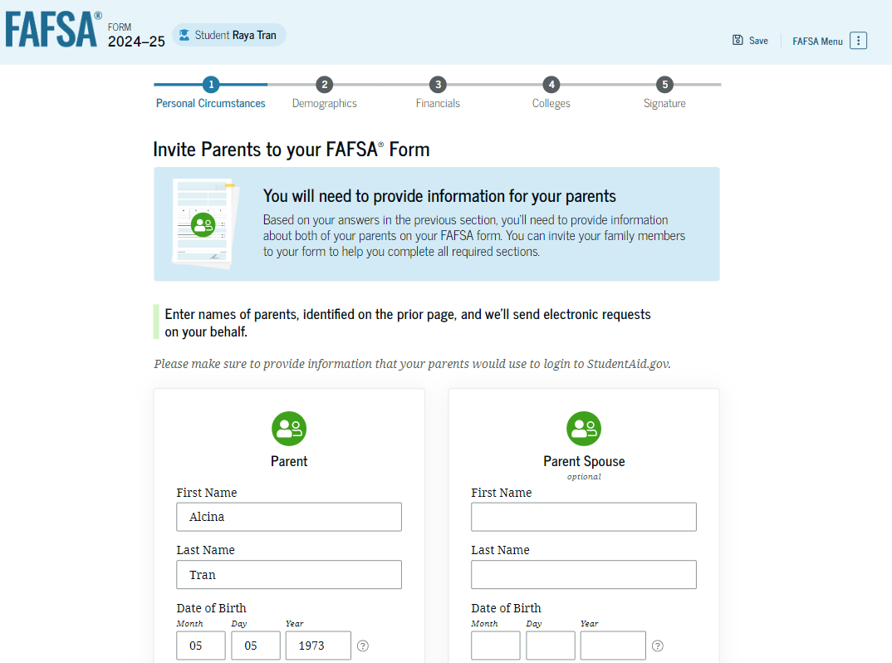
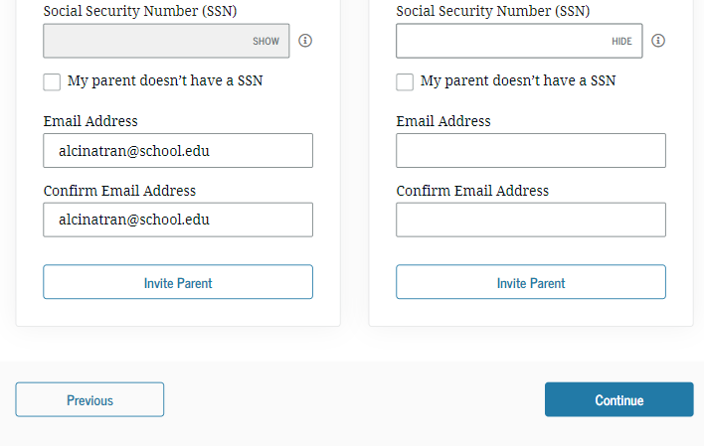
Dependent Student Invites Parents to FAFSA® Form
The student is asked to enter personal information about their parents in order to send them an invite to their FAFSA® form. In this scenario, the student invites one parent.

Slide 30
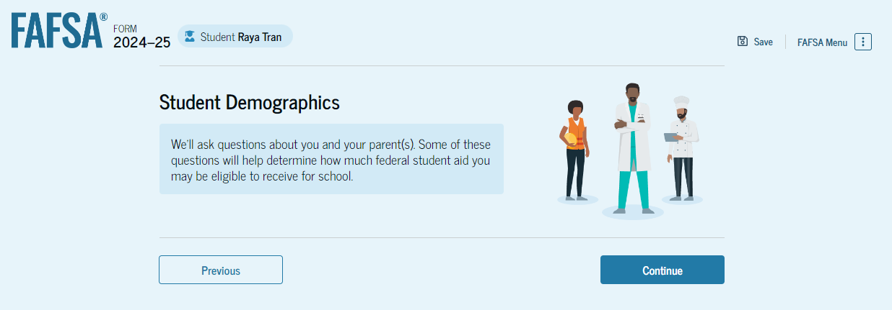
Introduction: Dependent Student Demographics
This is the first view within the Student Demographics section. It provides an overview of the section.

Slide 31
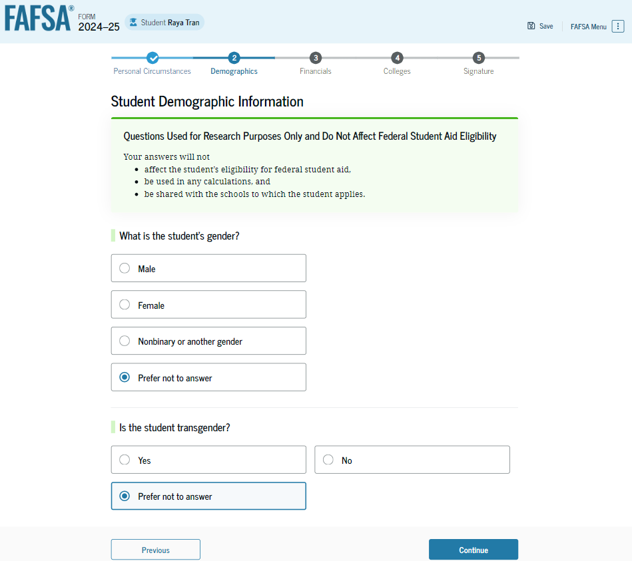
Dependent Student Demographic Information
The student is asked about their gender identity and if they are transgender. The student selects their response from the options for both questions.

Slide 32
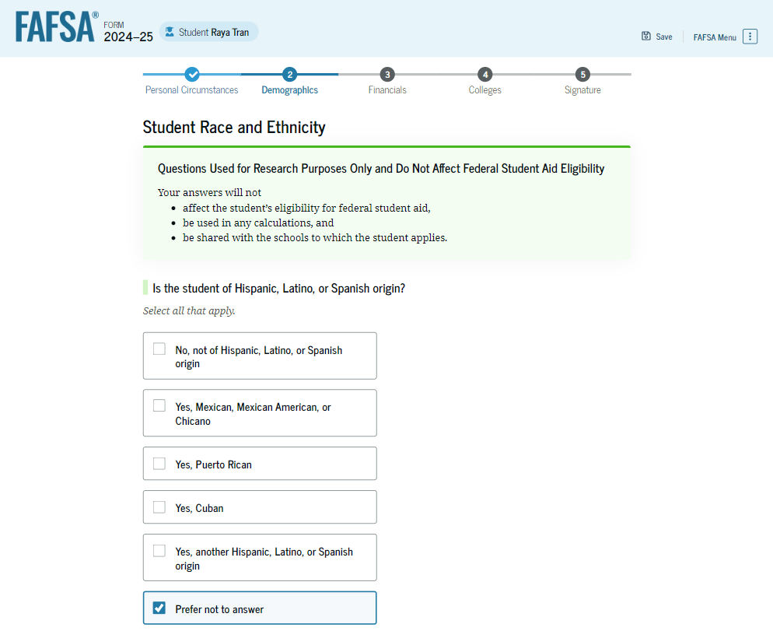
Dependent Student Race and Ethnicity
The student is asked if they are of Hispanic, Latino, or Spanish origin. They are also asked about their race. The student selects checkboxes to answer both questions.

Slide 33
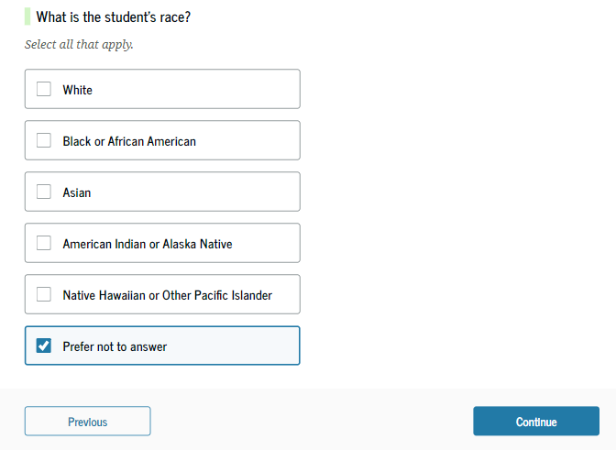
Dependent Student Race and Ethnicity (Continued)

Slide 34
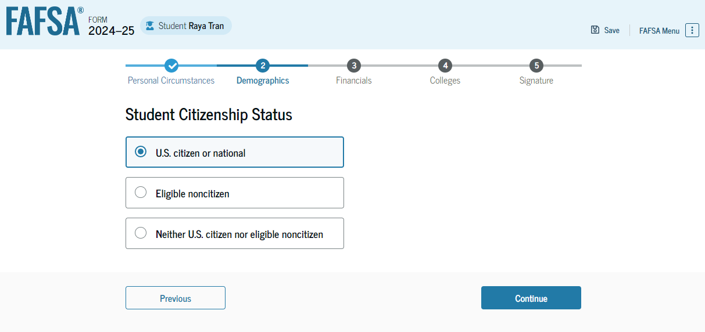
Dependent Student Citizenship Status
The student is asked about their citizenship status. The student selects the "U.S. citizen or national" option.

Slide 35
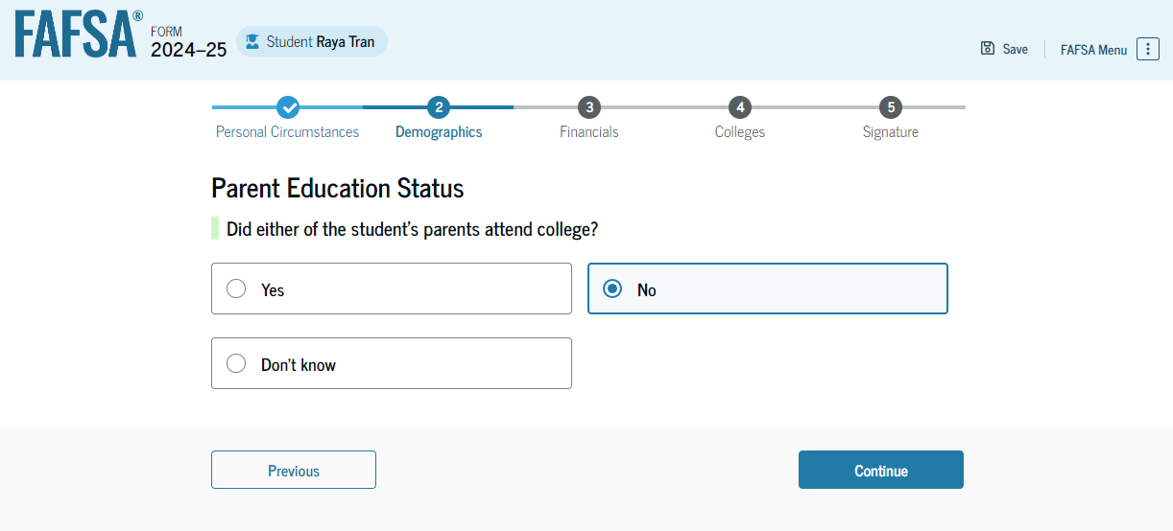
Dependent Student’s Parent Education Status
The student is asked about their parents’ education status. The student selects the “No” option.

Slide 36
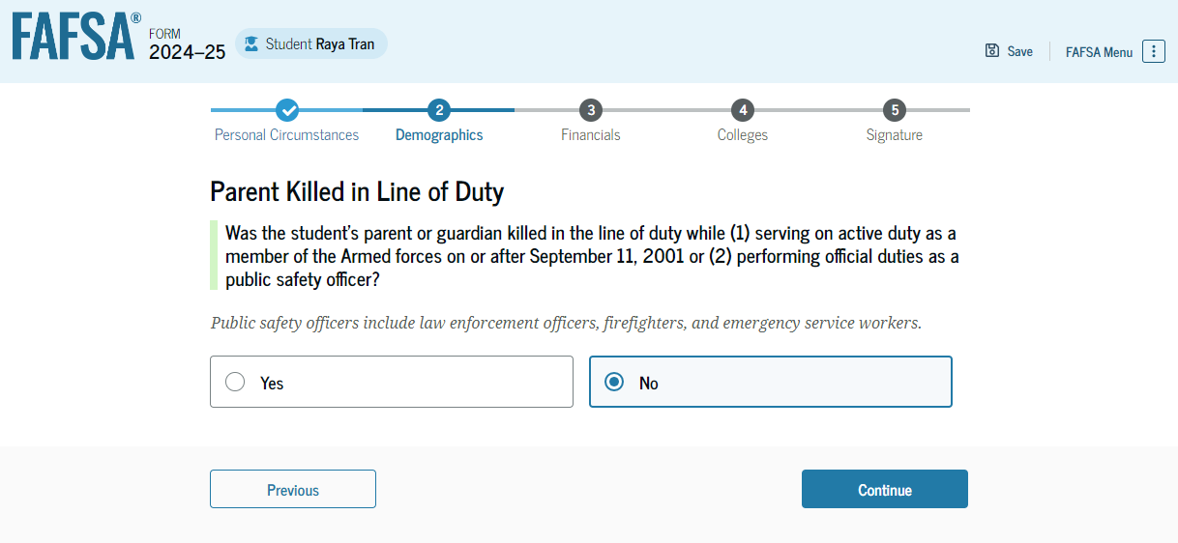
Dependent Student’s Parent Killed in Line of Duty
The student is asked if their parent was killed in the line of duty. The student selects the “No” option.

Slide 37
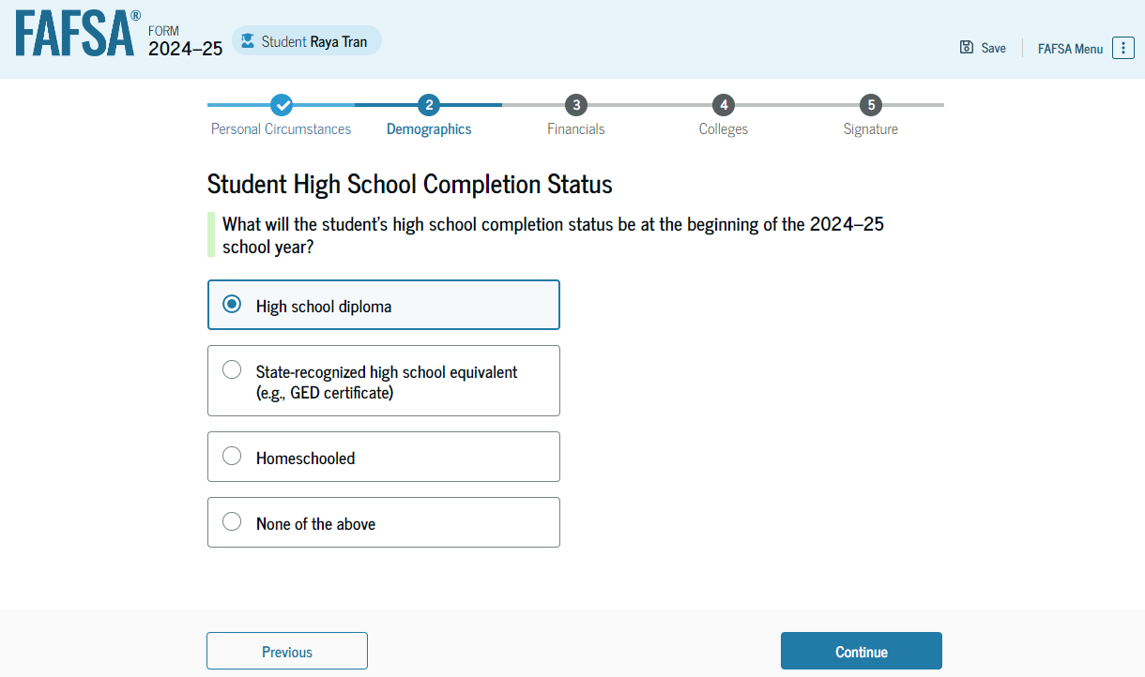
Dependent Student High School Completion Status
The student is asked about what their high school completion status will be when they start the 2024–25 school year. The student selects the "High school diploma" option.

Slide 38
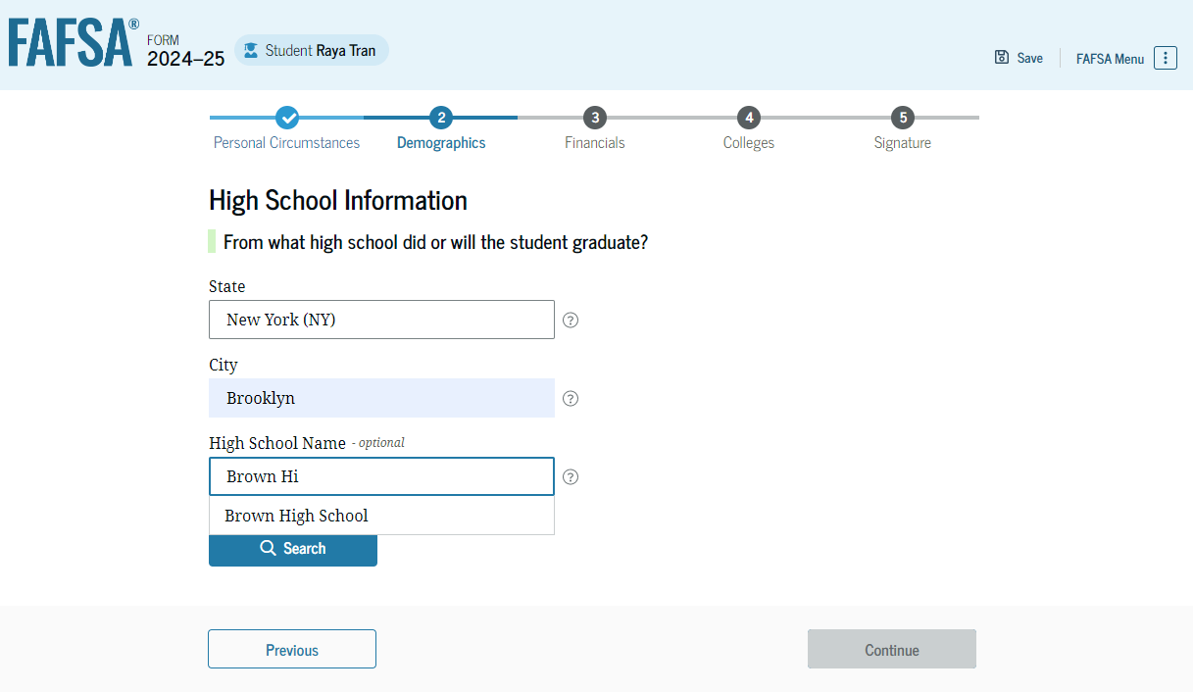
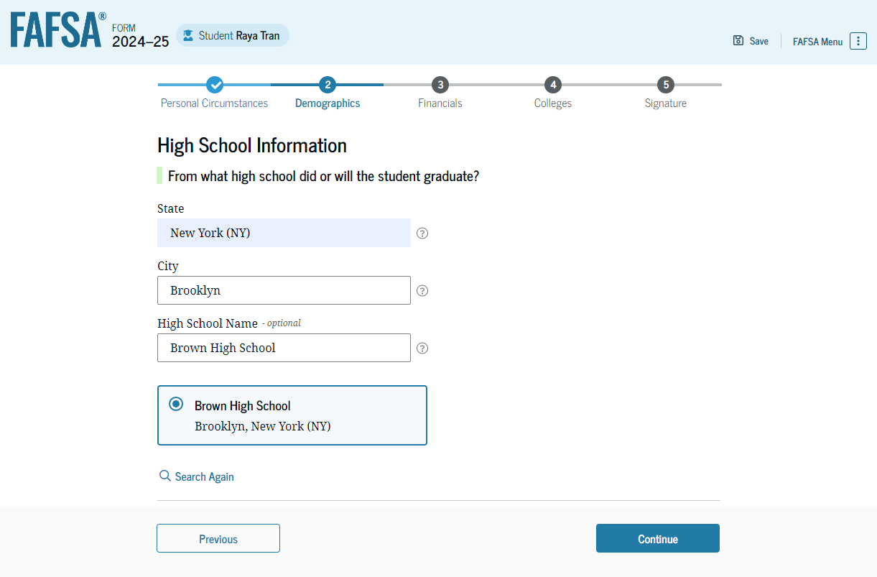
Dependent Student High School Information
The student is asked which high school they did or will graduate from. The student enters their high school’s state and city. After selecting "Search," they select the correct high school from the search results.

Slide 39
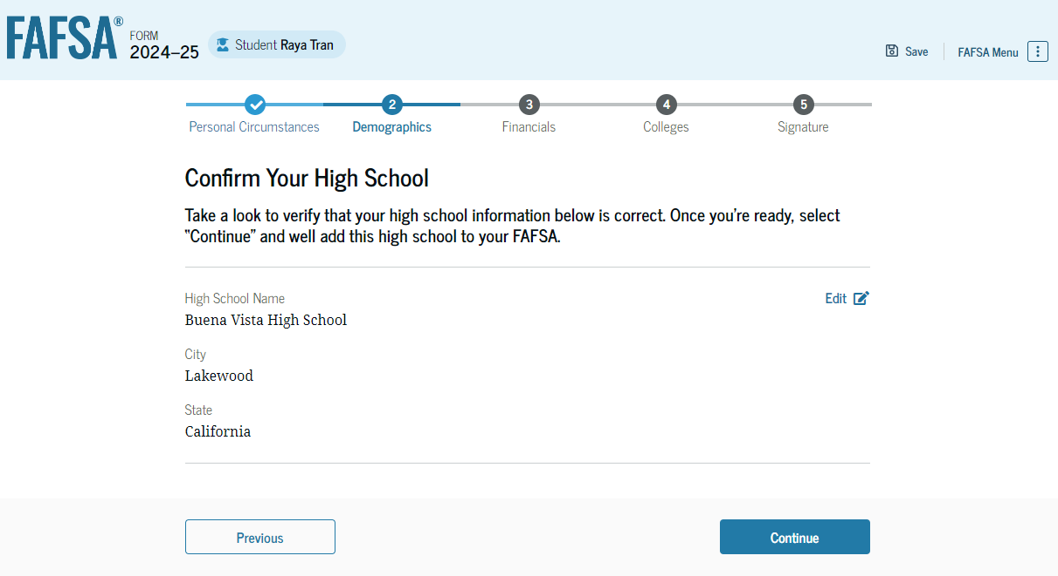
Dependent Student Confirms High School
The student has the option to edit the high school information presented on this page by selecting "Edit," which will return them to the high school information page. The student confirms their high school information and selects "Continue" to proceed to the next section.

Slide 40
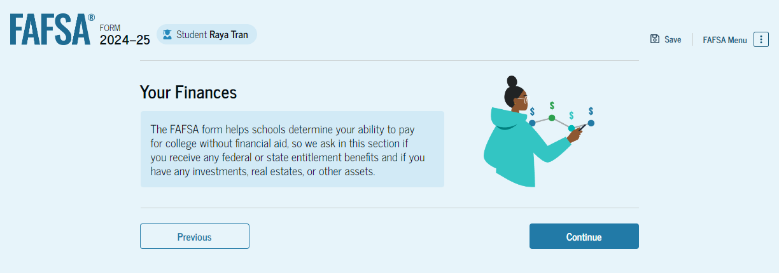
Introduction: Dependent Student Financials
This is the first page within the Student Financials section. It provides an overview of the section.

Slide 41
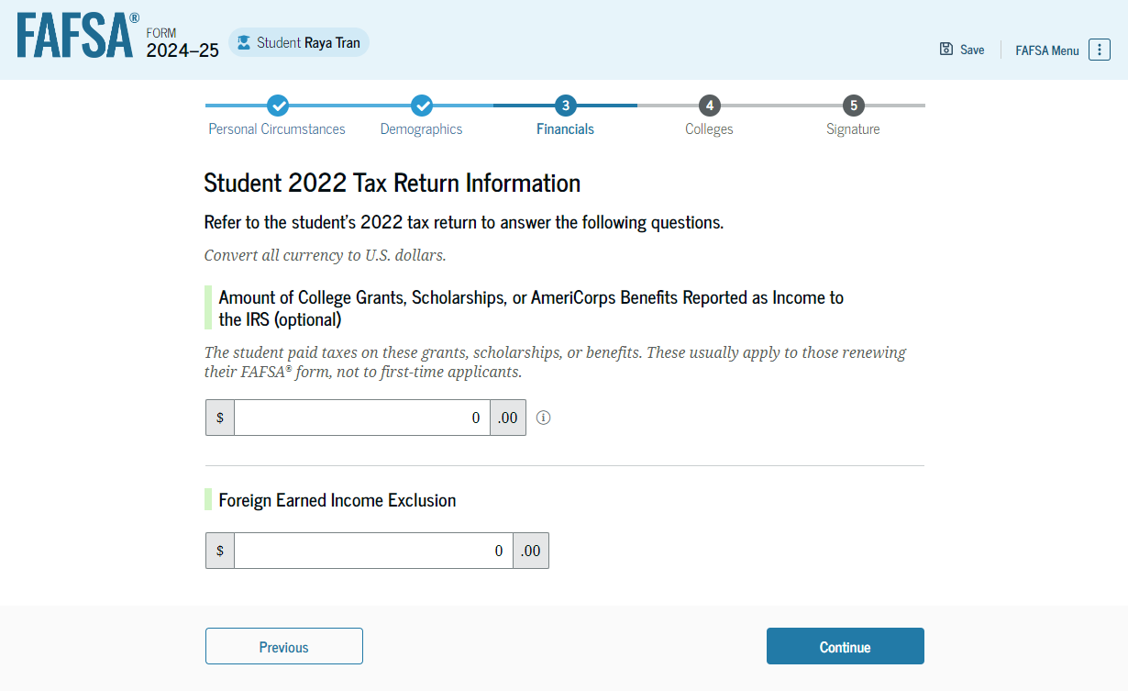
Dependent Student Tax Return Information
The student is asked questions about their 2022 tax return. The student enters a response in each entry field.

Slide 42
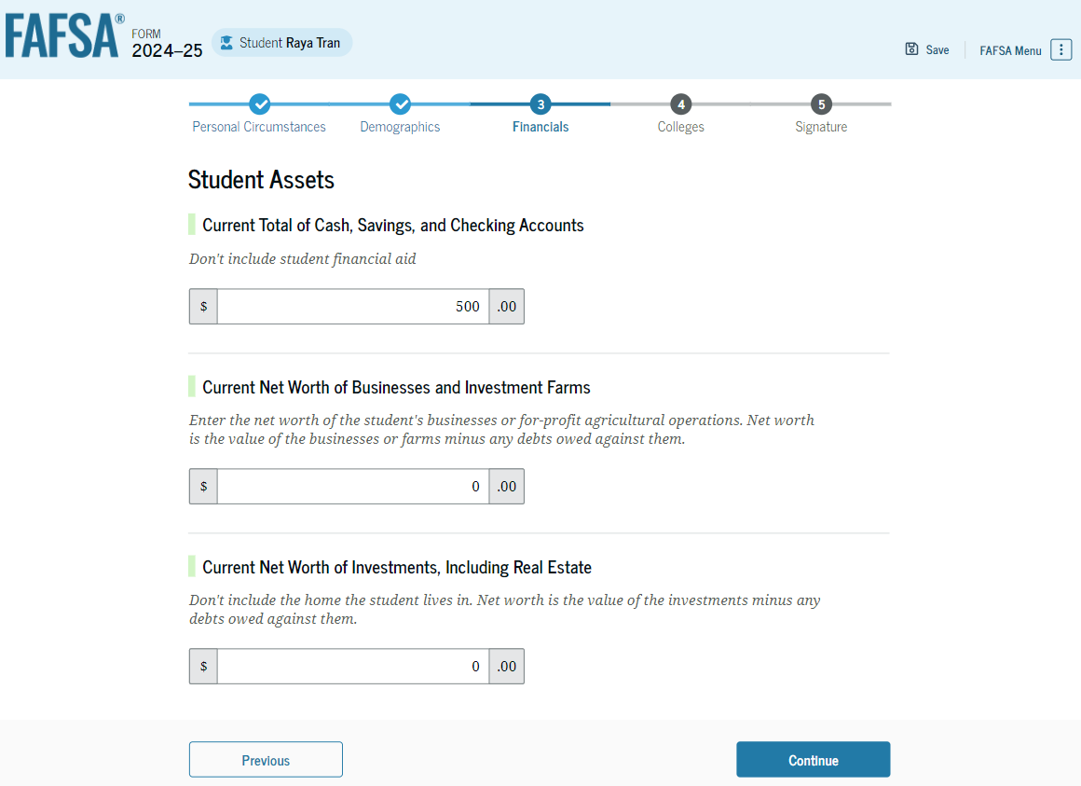
Dependent Student Assets
The student is asked about their assets. The student enters a response in each entry field.

Slide 43
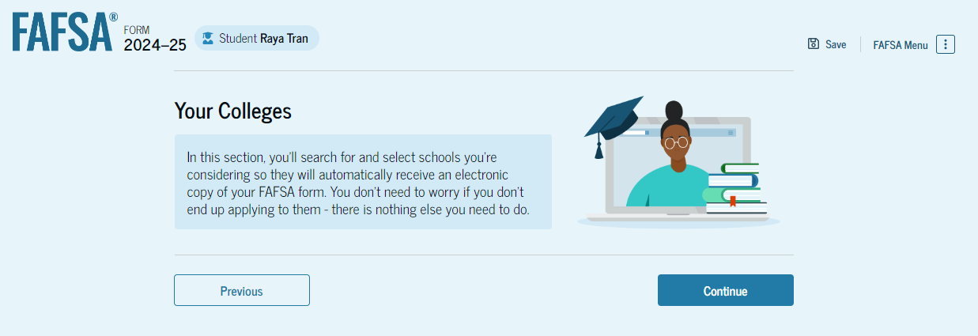
Introduction: Dependent Student Select Colleges
This is the first page in the Select Colleges section, which is the final part of the FAFSA® form’s student section to require information. It provides an overview of the section.

Slide 44
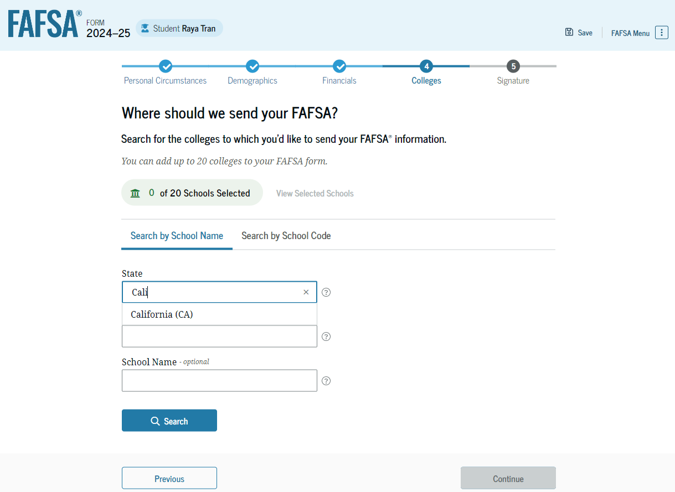
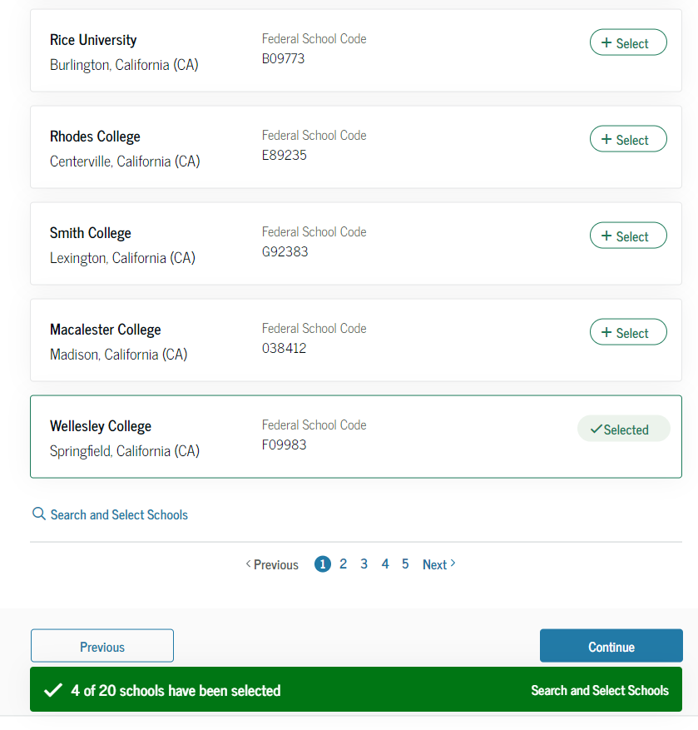
Dependent Student College Search
The student is asked to search for the colleges and/or career schools they would like to receive their FAFSA® information. The student searches for a school by entering a state, city, and/or school name. After selecting "Search," they select the correct school from the search results. Students can select to send their FAFSA information to a maximum of 20 schools.

Slide 45
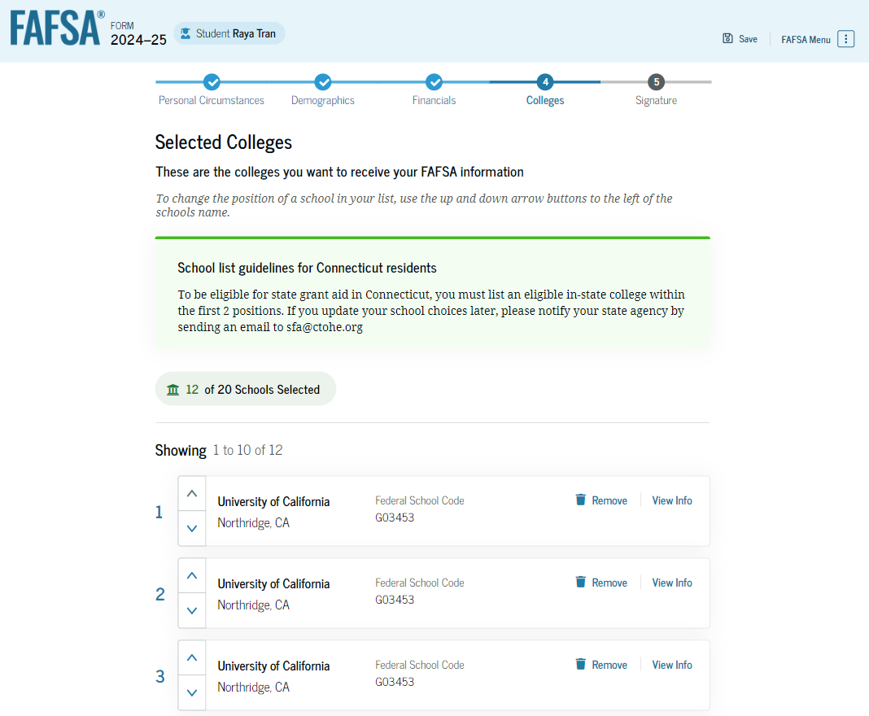
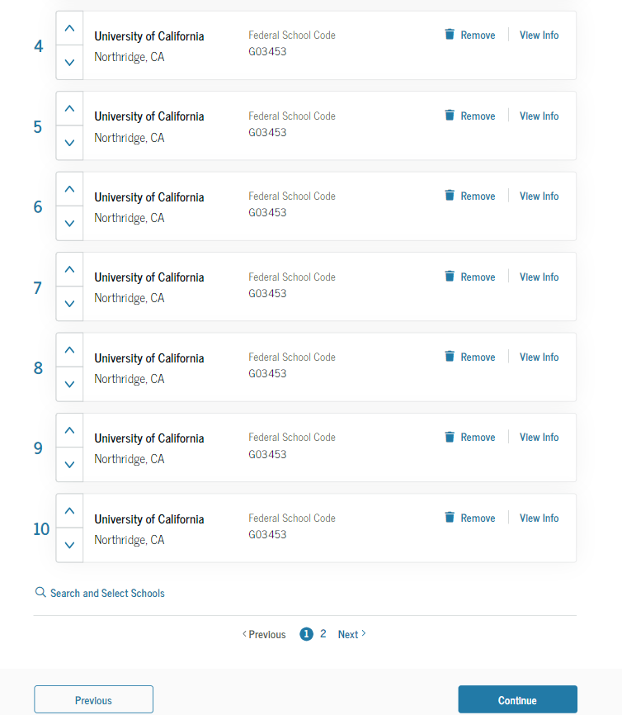
Dependent Student Selected Colleges
The student can view which colleges and/or career schools they have selected. If the student has not selected 20 schools, they have the option to search and select more schools, and for students in some states, they have the option to change the position of their selected schools. When the student selects "Continue," they will have completed entering the required student information for their section and can proceed to review and sign their form.

Slide 46
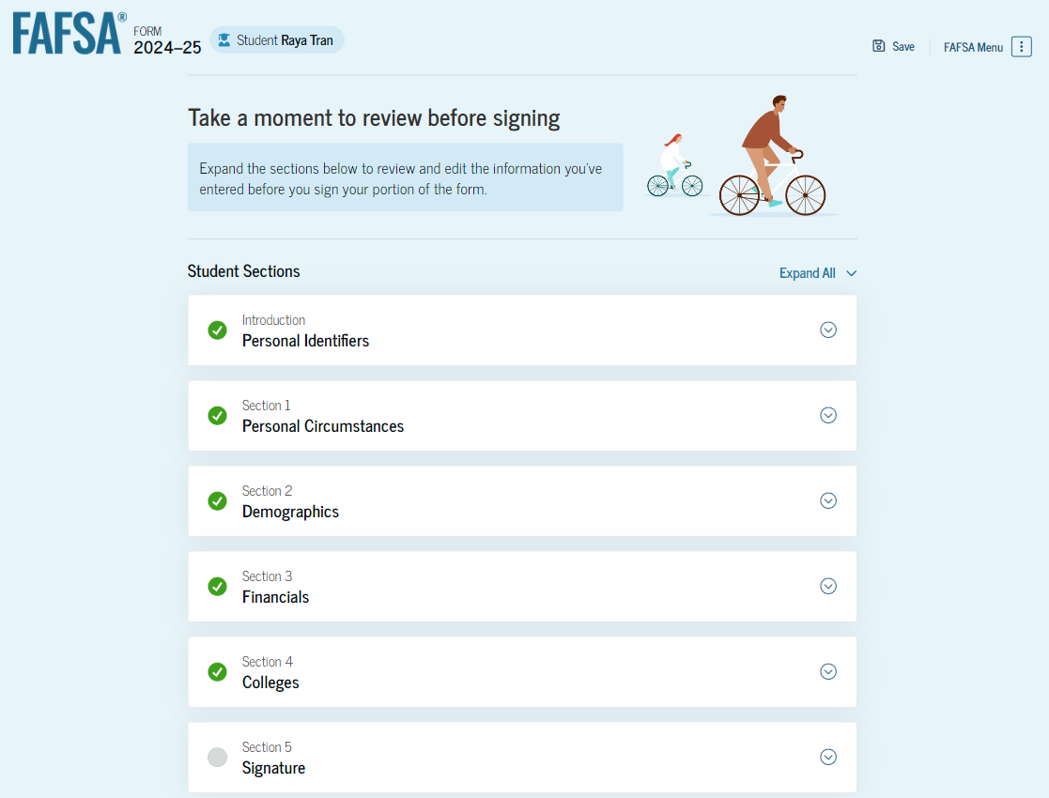
Dependent Student Review Page
The review page displays the responses that the student has provided in the FAFSA® form. The student can view all their responses by selecting "Expand All" or expand each section individually. To edit a response, the student can select the question’s hyperlink and will be taken to the corresponding page. Additionally, since the student invited their parent into the form, they see the parent contributor section and the status of their parent’s invite.

Slide 47
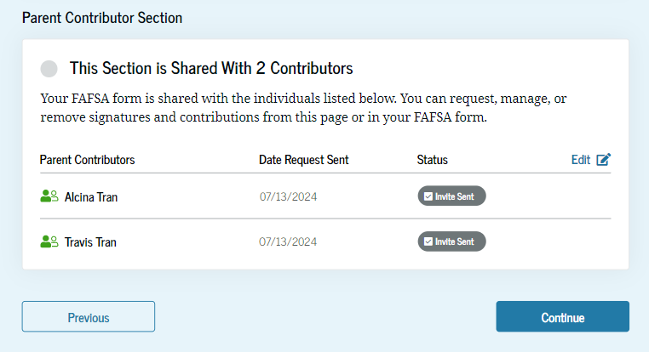
Dependent Student Review Page (Continued)

Slide 48
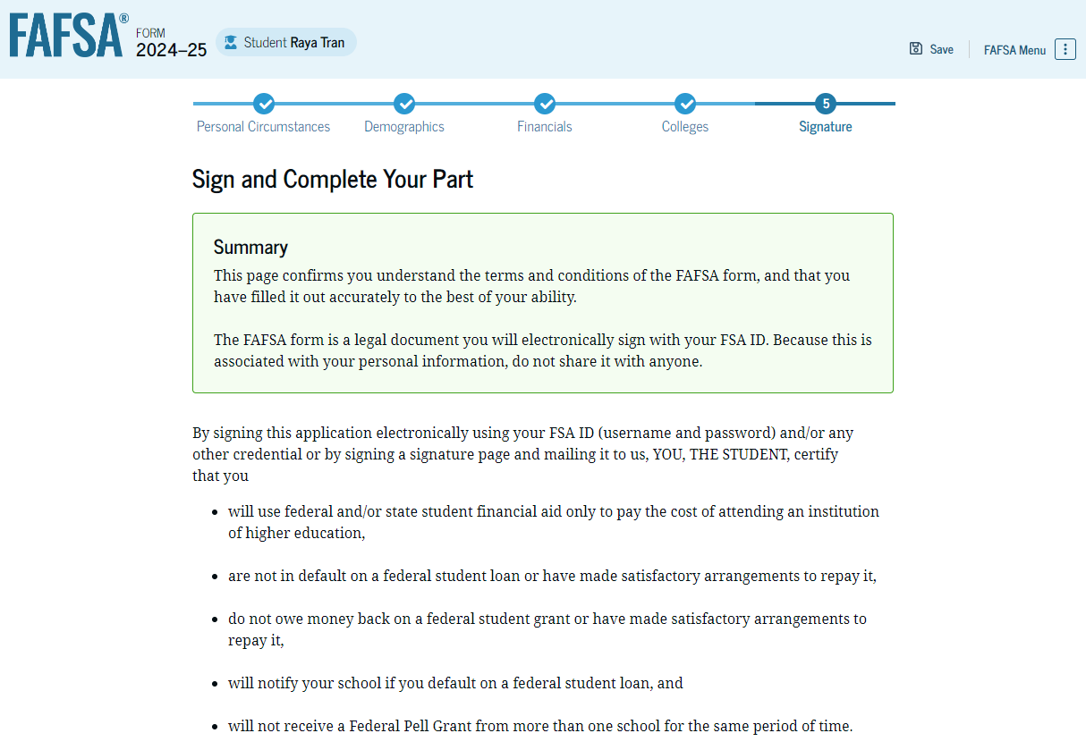
Dependent Student Signature
On this page, the student acknowledges the terms and conditions of the FAFSA® form and signs their section. After agreeing and signing, the student is able to submit their section of the FAFSA form. Since parent information has not been provided, the FAFSA form is not considered complete and can’t be processed yet.

Slide 49
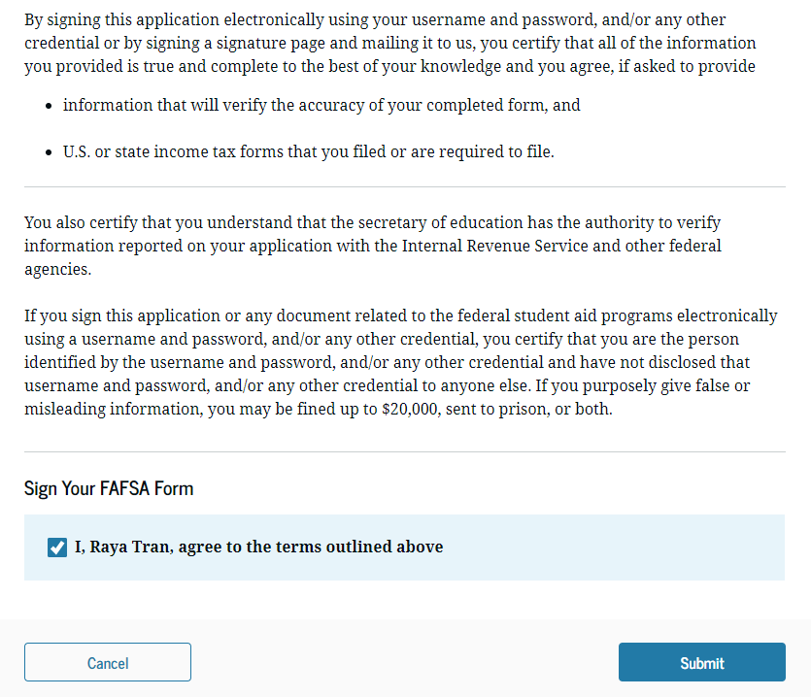
Dependent Student Signature (Continued)

Slide 50
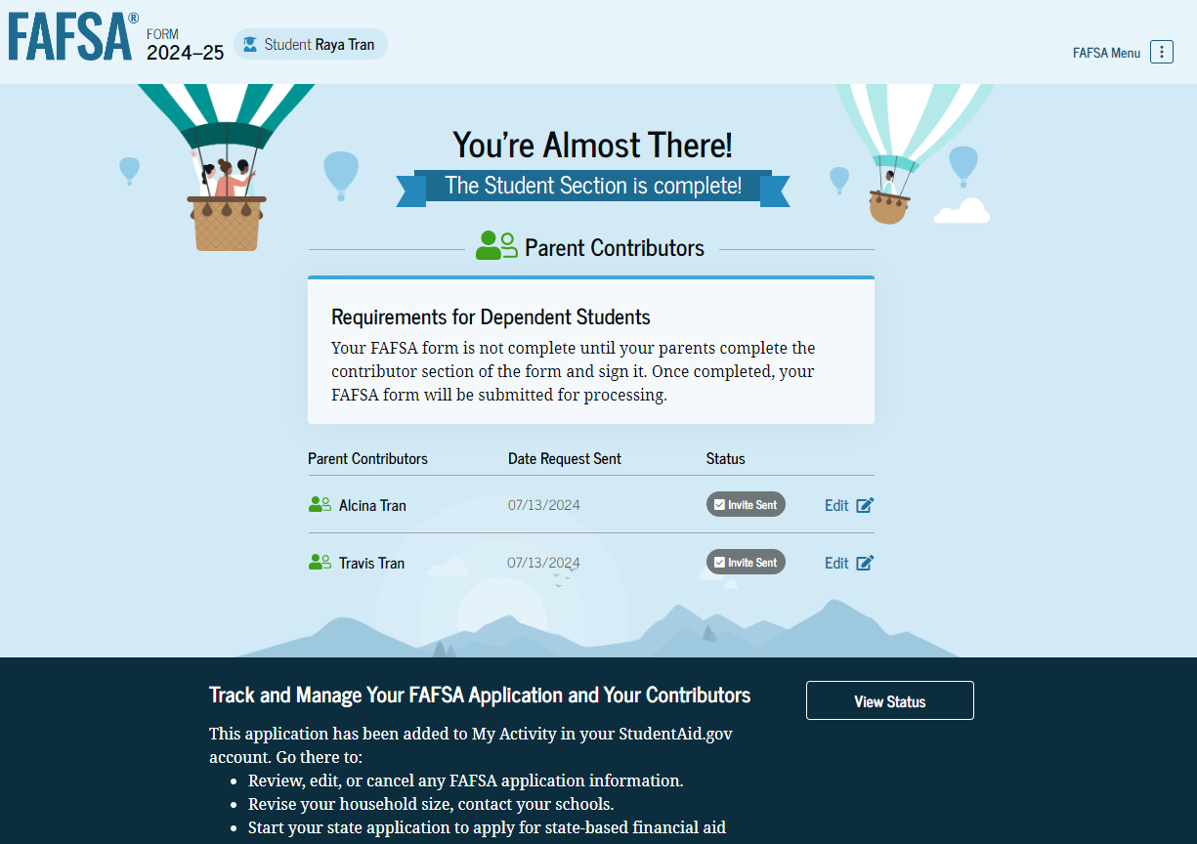
Dependent Student Section Complete
Upon signing the student section, the student is presented the student section complete page. This page displays information for the student about next steps, including tracking their FAFSA® form. The student is reminded that their form is not completed and can’t be submitted until the parent completes the contributor section of the form and signs it. Next, in this scenario, the student’s invited parent will enter the FAFSA form and complete the parent section.

Slide 51
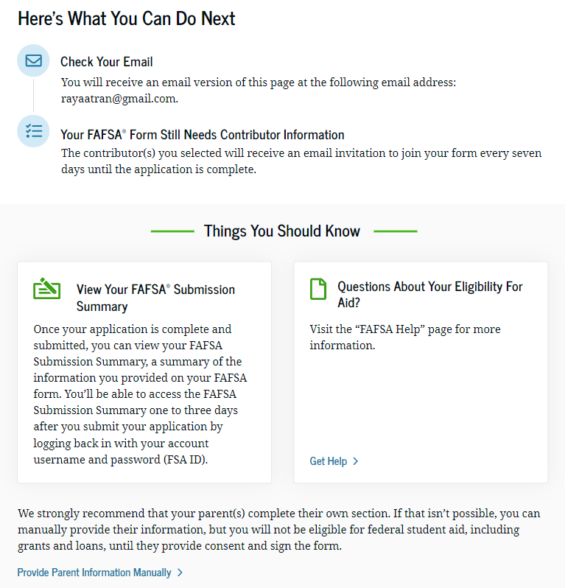
Dependent Student Section Complete (Continued)

Slide 52
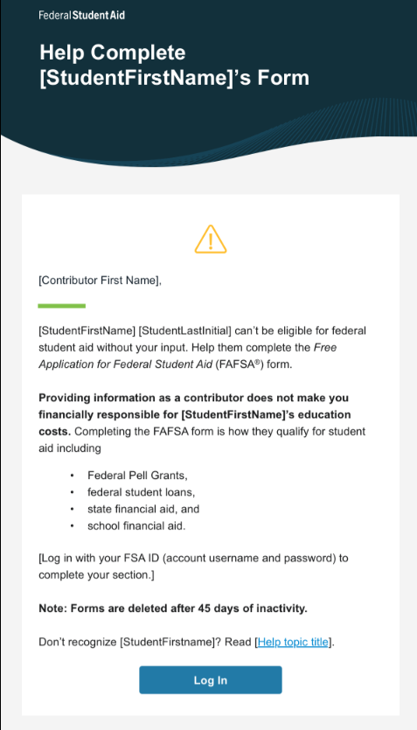
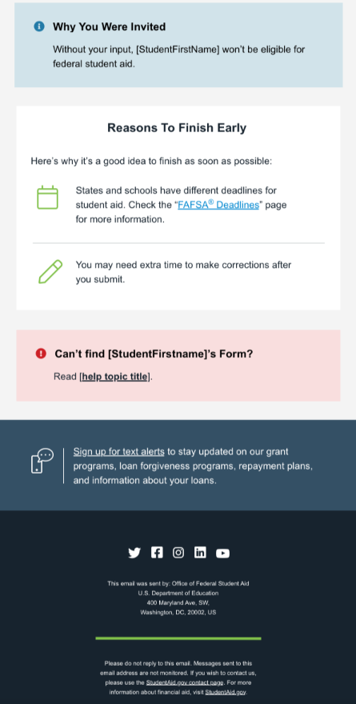
Dependent Student’s Parent Email
This is NOT a view within StudentAid.gov nor the FAFSA® form. This view demonstrates a parent opening the FAFSA invitation from their email. The parent selects “Log In" and is taken to StudentAid.gov.

Slide 53
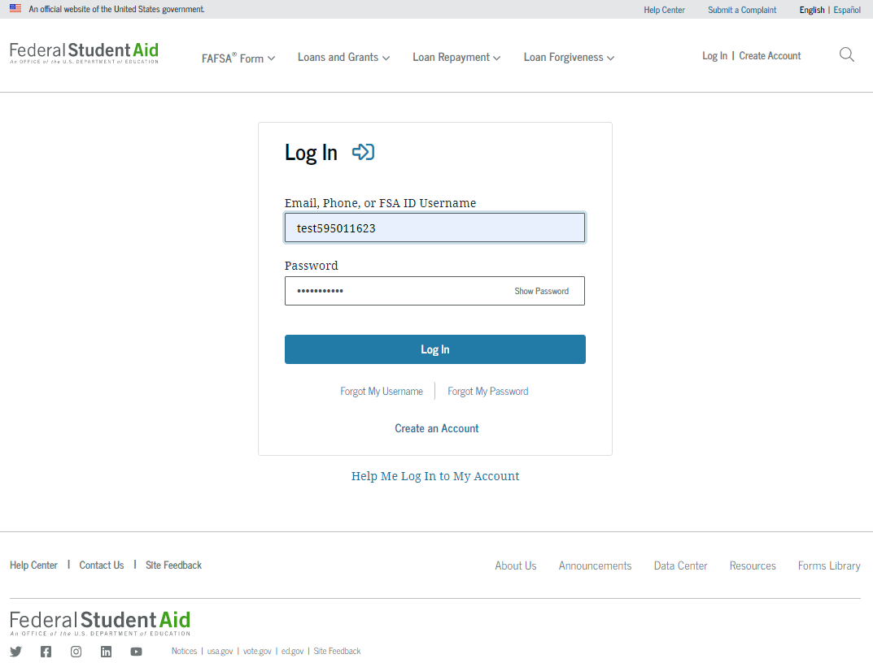
Dependent Student’s Parent Log In
The parent is taken from their email to the “Log In” page to enter their log-in credentials. To access the FAFSA® form, all users are required to have an FSA ID (account username and password). If the parent doesn't have an FSA ID, they can select "Create an Account."

Slide 54
Parent Status Center – My Activity
After successfully logging in, the parent is taken to their “My Activity” page. The parent sees an invitation to be a contributor on the student’s FAFSA® form.

Slide 55
Dependent Student’s Parent Contributing to the FAFSA® Form
This page provides information about being a contributor on a FAFSA® form.

Slide 56
Dependent Student’s Parent Onboarding (1 of 4)
When the parent enters a 2024–25 FAFSA® form for the first time, they are taken through the FAFSA onboarding process. The first onboarding page provides an overview of the FAFSA form and an accompanying video.

Slide 57
Dependent Student’s Parent Onboarding (2 of 4)
The second FAFSA® onboarding page provides information about the different roles that may be required to complete the student’s FAFSA form and the documents that may be needed to fill out the form.

Slide 58
Dependent Student’s Parent Onboarding (3 of 4)
The third onboarding page provides information about the types of questions the parent can expect to see and how they can get help in filling out the FAFSA® form.

Slide 59
Dependent Student’s Parent Onboarding (4 of 4)
The last onboarding page provides information about what to expect once the FAFSA® form is completed and submitted. On this page, the parent selects "Start the FAFSA form" to begin the parent section.

Slide 60
Dependent Student’s Parent Identity Information
This is the first page within the parent section. The parent can verify that their personal information is correct. To update any of the personal information, the parent must access their Account Settings on StudentAid.gov. For fields related to the parent’s mailing address, the parent can edit them directly on this page.

Slide 61
Dependent Student’s Parent Identity Information (Continued)

Slide 62
Dependent Student’s Parent Provides Consent
This page informs the parent about consent and their federal tax information. By providing consent, the parent’s federal tax information is transferred directly into the FAFSA® form from the IRS to help complete the Parent Financials section. The parent selects "Approve" to provide consent and is taken to the next page.

Slide 63
Dependent Student’s Parent Provides Consent (Continued)

Slide 64
Introduction: Dependent Student’s Parent Demographics
This is the first page in the Parent Demographics section. It provides an overview of the section.

Slide 65
Dependent Student’s Parent Current Marital Status
The parent is asked about their current marital status. They select the "Married (not Separated)" option.

Slide 66
Dependent Student’s Parent State of Legal Residence
The parent is asked about their state of legal residence. The parent selects the state from a dropdown box and provides the month and year when they became a legal resident.

Slide 67
Introduction: Dependent Student’s Parent Financials
This is the first page within the Parent Financials section. It provides an overview of the section.

Slide 68
Dependent Student’s Parent Federal Benefits Received
This page asks the parent if they or anyone in their family has received federal benefits. The parent selects "None of these apply."

Slide 69
Dependent Student’s Parent Tax Filing Status
This page asks the parent about their tax filing status. The parent selects "Yes" to "Did or will the parent file a 2022 joint tax return with their current spouse?"

Slide 70
Dependent Student’s Parent Family Size
This page asks the parent if their family size has changed. The parent selects the “Yes“ option.

Slide 71
Dependent Student’s Parent Number in College
This page asks the parent how many people in the family will be in college between July 1, 2024, and June 30, 2025. The parent enters a response into the entry field.

Slide 72
Dependent Student’s Parent Tax Return Information
The parent is asked questions about their 2022 tax return. The parent enters a response in each entry field.

Slide 73
Dependent Student’s Parent Assets
The parent is asked about their assets. The parent enters a response in each entry field.

Slide 74
Dependent Student’s Other Parent Information
The parent is asked to provide information about their spouse or partner.

Slide 75
Dependent Student’s Parent Review Page
The review page displays the responses that the parent has provided in the FAFSA® form. In this scenario, the parent can only view responses within the parent section of the student’s FAFSA form. The parent can view all their responses by selecting "Expand All" or expand each section individually. To edit a response, the parent can select the question’s hyperlink to be taken to the corresponding page.

Slide 76
Dependent Student’s Parent Signature
On this page, the parent acknowledges the terms and conditions of the FAFSA® form and signs their section. Since all required sections are complete, the parent can both sign and submit the student’s FAFSA form.

Slide 77
Dependent Student FAFSA® Confirmation
Upon submitting the student’s FAFSA® form, the parent is presented an abbreviated confirmation page. This page displays information about tracking the student’s FAFSA form and next steps. The student will receive an email with the full, detailed confirmation. With the student and parent sections completed and signed, the FAFSA form is now considered complete and submitted for processing.

Slide 78
Parent Starts and Submits a FAFSA® Form Without Student Consent or Signature

Slide 79
Parent FAFSA® Form Landing Page
This is the main FAFSA® form landing page. On this page, students and parents are directed to "Start a New Form" or "Edit Existing Form." For the purpose of this presentation, the parent is beginning a new application on behalf of their child.

Slide 80
Parent Log In
If the parent selects "Start a New Form" from the FAFSA® landing page and they are not logged in to StudentAid.gov, they are taken to the "Log In" page to enter their log-in credentials. To access the FAFSA form, all parents are required to have an FSA ID (account username and password). If the parent doesn't have an FSA ID, they can select "Create an Account."​

Slide 81
Parent Roles
After logging in, the parent selects the applicable role to fill out the FAFSA® form: "Parent."

Slide 82
Parent’s Student Information
The parent is asked to provide the student’s information. Since the student has not started a FAFSA® form yet, they will receive an email notifying them that a FAFSA form was started on their behalf. The student can then enter the form to provide consent, sign the form, and make any needed corrections.

Slide 83
Parent’s Student Information (Continued)

Slide 84
Parent Onboarding (1 of 4)
When the parent starts the 2024–25 FAFSA® form for the first time, they are taken through the FAFSA onboarding process. The first onboarding page provides an overview of the FAFSA form and an accompanying video.

Slide 85
Parent Onboarding (2 of 4)
The second FAFSA® onboarding page provides information about the different roles that may be required to participate in the student’s FAFSA form and documents that may be needed to fill out the form.

Slide 86
Parent Onboarding (3 of 4)
The third FAFSA® onboarding page provides information about the types of questions the parent can expect to see and how they can get additional help with filling out the FAFSA form.​

Slide 87
Parent Onboarding (4 of 4)
The final FAFSA® onboarding page provides information about what to expect once the FAFSA form is completed and submitted. On this page, the parent can select "Start the FAFSA form" to begin.

Slide 88
Parent’s Student Identity Information
After starting the FAFSA® form, the parent sees the first page within the student section. The parent can verify that the student’s personal information is correct. To update any of the personal information, the student must access their Account Settings on StudentAid.gov. For fields related to the student’s mobile phone number and mailing address, the parent can edit them directly on this page.

Slide 89
Parent’s Student Identity Information (Continued)

Slide 90
Parent’s Student State of Legal Residence
The parent is asked about the student’s state of legal residence. The parent selects the state from a dropdown box and provides the month and year when the student became a legal resident.

Slide 91
Introduction: Parent’s Student Personal Circumstances
This is the first page within the Student Personal Circumstances section. It provides an overview of the section.

Slide 92
Parent’s Student Marital Status
The parent is asked about the student’s marital status. The parent selects the "Single (Never Married)" option.

Slide 93
Parent’s Student College or Career School Plans
The parent is asked about the student’s college grade level for the 2024–25 school year and if the student will have their first bachelor’s degree. The parent selects that the student will be a "First Year (freshman)" and that they will not have their first bachelor’s degree.

Slide 94
Parent’s Student Personal Circumstances
The parent is asked if any of the listed personal circumstances apply to the student. The parent selects the "None of these apply" option.

Slide 95
Parent’s Student Other Circumstances
The parent is asked if the student was homeless or at risk of being homeless. The parent selects "No."

Slide 96
Parent’s Student Unusual Circumstances
The parent is asked if unusual circumstances prevent the student from contacting their parent(s). The parent selects "No."

Slide 97
Parent’s Student Dependency Status: Dependent Student
Based on the answers provided by the parent, the student is considered a dependent student. The parent is asked if they want a financial aid administrator to determine the student’s eligibility for a Direct Unsubsidized Loan only. This is an option if they are unwilling to provide their information. The parent selects "No."

Slide 98
Parent Identity Information
This is the first page within the parent section. The parent can verify that their personal information is correct. To update any of the personal information, the parent must access their Account Settings on StudentAid.gov. For fields related to the parent’s mailing address, the parent can edit them directly on this page.

Slide 99
Parent Identity Information (Continued)

Slide 100
Parent Provides Consent
This page informs the parent about consent and their federal tax information. By providing consent, the parent’s federal tax information is transferred directly into the FAFSA® form from the IRS to help complete the Parent Financials section. The parent selects "Approve" to provide consent and is taken to the next page.

Slide 101
Parent Provides Consent (Continued)

Slide 102
Introduction: Parent Demographics
This is the first page in the Parent Demographics section. It provides an overview of the section.

Slide 103
Parent Current Marital Status
The parent is asked about their current marital status. They select the "Single (Never Married)" option.

Slide 104
Parent State of Legal Residence
The parent is asked about their state of legal residence. The parent selects the state from a dropdown box and provides the month and year when they became a legal resident.

Slide 105
Introduction: Parent Financials
This is the first page within the Parent Financials section. It provides an overview of the section.

Slide 106
Parent Federal Benefits Received
This page asks the parent if they or anyone in their family has received federal benefits. The parent selects "None of these apply."

Slide 107
Parent Family Size
This page asks the parent if their family size has changed since filing their 2022 tax return. The parent selects the "No" option.

Slide 108
Parent Number in College
This page asks the parent how many people in the family will be in college between July 1, 2024, and June 30, 2025. The parent enters a response into the entry field.

Slide 109
Parent Tax Return Information
The parent is asked questions about their 2022 tax return. They enter a response in each entry field.

Slide 110
Parent Assets
The parent is asked about their assets. They enter a response in each entry field.

Slide 111
Parent Review Page
The review page displays the responses that the parent has provided in the previous student and parent sections of the student’s FAFSA® form. The parent can view all their responses by selecting "Expand All" or expand each section individually. To edit a response, they can select the question’s hyperlink to be taken to the corresponding page.

Slide 112
Parent Signature
On this page, the parent acknowledges the terms and conditions of the FAFSA® form and signs their section. After agreeing and signing, the parent is able to submit their section of the FAFSA form. Since the student section is incomplete, the FAFSA form is not considered complete and can’t be processed yet. ​

Slide 113
Parent Section Complete
Upon signing the parent section, the parent is presented the parent section complete page. This page displays information for the parent about next steps, including tracking the student’s FAFSA® form. The parent is reminded that the student’s form is not complete and can’t be processed until the student section is complete. Next, in this scenario, the parent selects “Provide Student Information Manually" and enters the student section.
This screenshot is currently unavailable. It will be available in a future preview presentation scheduled for December 2023.

Slide 114
Introduction: Parent’s Student Demographics
This is the first view within the Student Demographics section. It provides an overview of the section.

Slide 115
Parent’s Student Demographic Information
The parent is asked about the student’s gender identity and if the student is transgender. The parent selects a response from the options for both questions.

Slide 116
Parent’s Student Race and Ethnicity
The parent is asked if the student is of Hispanic, Latino, or Spanish origin. They are also asked about the student’s race. The parent selects checkboxes to answer both questions.

Slide 117
Parent’s Student Citizenship Status
The parent is asked about the student’s citizenship status. The parent selects the "U.S. citizen or national" option.

Slide 118
Parent Education Status
The parent is asked about their education status. They select the "No" option.

Slide 119
Parent Killed in Line of Duty
The parent is asked if the student's parent or guardian was killed in the line of duty. The parent selects the "No" option.

Slide 120
Parent’s Student High School Completion Status
The parent is asked what the student’s high school completion status will be when they start the 2024–25 school year. The parent selects the "High school diploma" option.

Slide 121
Parent’s Student High School Information
The parent is asked which high school the student did or will graduate from. The parent enters the student’s high school’s state and city. After selecting "Search," they select the correct high school from the search results. ​

Slide 122
Parent Confirms High School
The parent is asked to confirm the high school information. By selecting "Edit," they will return to the high school information page. The parent verifies the student’s high school information and selects "Continue" to proceed to the next section.

Slide 123
Introduction: Parent’s Student Financials
This is the first page within the Student Financials section. It provides an overview of the section.

Slide 124
Parent’s Student Tax Filing Status
This page asks the parent about the student’s tax filing status. The parent selects "Yes" to "Did or will the student file a 2022 IRS Form 1040 or 1040-NR?"

Slide 125
Parent’s Student Tax Return Information
Since the student has not provided consent for their federal tax information to be transferred directly into the FAFSA® form, the parent is asked to manually enter the student’s 2022 tax return information. The parent enters a response in each entry field. ​
This screenshot is currently unavailable. It will be available in a future preview presentation scheduled for December 2023.

Slide 126
Parent’s Student Assets
The parent is asked about the student’s assets. The parent enters a response in each entry field.

Slide 127
Introduction: Parent Select Colleges
This is the first page in the Select Colleges section, which is the final part of the FAFSA® form’s student section to require information. It provides an overview of the section.

Slide 128
Parent College Search
The parent is asked to search for the colleges and/or career schools they would like to receive the student’s FAFSA® information. The parent searches for a school by entering a state, city, and/or school name. After selecting "Search," they select the correct school from the search results. Parents can select to send the student’s FAFSA information to a maximum of 20 schools.

Slide 129
Parent College Search (Continued)

Slide 130
Parent Selected Colleges
The parent can view which colleges and/or career schools they have selected for the student. If the parent has not selected 20 schools, they have the option to search and select more schools, and, in some states, they have the option to change the position of their selected schools. When the parent selects "Continue," they will have completed entering the required student information for the student section and can proceed to the review page.

Slide 131
Parent Selected Colleges (Continued)

Slide 132
Parent’s Student Review Page
The review page displays the responses that the parent has provided in the FAFSA® form on behalf of the student. The parent can view all the responses by selecting "Expand All" or expanding each section individually. To edit a response, the parent can select the question’s hyperlink and will be taken to the corresponding page. The parent cannot provide a signature for the student.

Slide 133
Parent’s Student Section Complete
The parent is presented the student section complete page. This page displays information for the parent about next steps, including tracking the student’s FAFSA® form. Because the student’s consent and signature are missing, the student is currently ineligible for federal student aid, including grants and loans. The student must enter their form, provide consent and signature, and submit the student section for their FAFSA form to be processed.

Slide 134
Independent Student Invites Student Spouse

Slide 135
Married Student FAFSA® Form Landing Page
This is the main FAFSA® form landing page. On this page, students are directed to "Start a New Form" or "Edit Existing Form." For the purpose of this presentation, the student is beginning a new application.

Slide 136
Married Student Log In
If the student selects "Start a New Form" from the FAFSA® landing page and they are not logged in to StudentAid.gov, they are taken to the "Log In" page to enter their log-in credentials. To access the FAFSA form, all students are required to have an FSA ID (account username and password). If the student doesn't have an FSA ID, they can select "Create an Account."

Slide 137
Married Student Roles
After logging in, the student selects the applicable role to fill out the FAFSA® form: “Student.”

Slide 138
Married Student Onboarding (1 of 4)
When the student starts the 2024–25 FAFSA® form for the first time, they are taken through the FAFSA onboarding process. The first onboarding page provides an overview of the FAFSA form and an accompanying video.

Slide 139
Married Student Onboarding (2 of 4)
The second FAFSA® onboarding page provides information about the different roles that may be required to participate in the student’s FAFSA form and documents that may be needed to fill out the form.

Slide 140
Married Student Onboarding (3 of 4)
The third FAFSA® onboarding page provides information about the types of questions the student can expect to see and how they can get additional help with filling out the FAFSA form.

Slide 141
Married Student Onboarding (4 of 4)
The last FAFSA® onboarding page provides information about what to expect once the FAFSA form is completed and submitted. On this page, the student can select "Start the FAFSA form" to begin.

Slide 142
Married Student Identity Information
This is the first page within the student section. The student can verify that their personal information is correct. To update any of the personal information, the student must access their Account Settings on StudentAid.gov. For fields related to the student’s mailing address, the student can edit them directly on this page.

Slide 143
Married Student Identity Information (Continued)

Slide 144
Married Student State of Legal Residence
The student is asked about their state of legal residence. The student selects the state from a dropdown box and provides the month and year when they became a legal resident.

Slide 145
Married Student Provides Consent
This page informs the student about consent and their federal tax information. By providing consent, the student’s federal tax information is transferred directly into the FAFSA® form from the IRS to help complete the Student Financials section. The student selects "Approve" to provide consent and is taken to the next page.

Slide 146
Married Student Provides Consent (Continued)

Slide 147
Introduction: Married Student Personal Circumstances
This is the first page within the Student Personal Circumstances section. It provides an overview of the section.

Slide 148
Married Student Marital Status
The student is asked about their marital status. The student selects the “Married (not Separated)" option.

Slide 149
Married Student College or Career School Plans
The student is asked about their college grade level for the 2024–25 school year and if they will have their first bachelor’s degree. The student selects “College graduate, professional, or beyond (MBA, M.D., PH.D., etc.)" and that they will have their first bachelor’s degree. Because they have answered, “Yes,” the student is asked if they will be pursuing an initial teaching certification. The student selects “No.”

Slide 150
Married Student Personal Circumstances
The student is asked if any of the listed personal circumstances apply to them. The student selects the "None of these apply" option.

Slide 151
Married Student Other Circumstances
The student is asked if they were homeless or at risk of being homeless. The student selects "No."

Slide 152
Married Student Dependency Status: Independent Student
Based on the answers provided by the student, they are considered an independent student. The student is not required to provide information about their parents due to this status. Since they are married and did not file taxes jointly with their spouse, the spouse will be required to provide information to complete the FAFSA® form.

Slide 153
Invite Spouse to Your FAFSA® Form
The student is asked to enter the personal information of their spouse in order to send them an invite to their FAFSA® form.

Slide 154
Introduction: Married Student Demographics
This is the first view within the Student Demographics section. It provides an overview of the section.

Slide 155
Married Student Demographic Information
The student is asked about their gender identity and if they are transgender. The student selects their response from the options for both questions.

Slide 156
Married Student Race and Ethnicity
The student is asked if they are of Hispanic, Latino, or Spanish origin. They are also asked about their race. The student selects checkboxes to answer both questions.

Slide 157
Married Student Citizenship Status
The student is asked about their citizenship status. The student selects the "U.S. citizen or national" option.

Slide 158
Married Student’s Parent Education Status
The student is asked about their parents’ education status. The student selects the "No" option.

Slide 159
Married Student’s Parent Killed in Line of Duty
Since the student is under the age of 33, they are asked if their parent was killed in the line of duty. The student selects the "No" option.

Slide 160
Married Student High School Completion Status
The student is asked about what their high school completion status will be when they start the 2024–25 school year. The student selects the "High school diploma" option.

Slide 161
Married Student High School Information
The student is asked which high school they did or will graduate from. The student enters their high school’s state and city. After selecting "Search," they select the correct high school from the search results.

Slide 162
Married Student Confirms High School
The student has the option to edit the high school information presented on this page by selecting "Edit," which will return them to the high school information page. The student confirms their high school information and selects "Continue" to proceed to the next section.

Slide 163
Introduction: Married Student Financials
This is the first page within the Student Financials section. It provides an overview of the section.

Slide 164
Married Student Federal Benefits Received
This page asks the student if they or anyone in their family has received federal benefits. The student selects "None of these apply."

Slide 165
Married Student Family Size
This page asks the student if their family size has changed since filing their 2022 tax return. The student selects the “No” option.

Slide 166
Married Student Number in College
This page asks the student how many people in the family will be in college between July 1, 2024, and June 30, 2025. The student enters a response into the entry field.

Slide 167
Married Student Tax Return Information
The student is asked questions about their 2022 tax return. The student enters a response in each entry field.

Slide 168
Married Student Assets
The student is asked about their and their spouse’s assets. The student enters a response in each entry field.

Slide 169
Introduction: Married Student Select Colleges
This is the first page in the Select Colleges section, which is the final part of the FAFSA® form’s student section to require information. It provides an overview of the section.

Slide 170
Married Student College Search
The student is asked to search for the colleges and/or career schools they would like to receive their FAFSA® information. The student searches for a school by entering a state, city, and/or school name. After selecting "Search," they select the correct school from the search results. Students can select to send their FAFSA information to a maximum of 20 schools.

Slide 171
Married Student Selected Colleges
The student can view which colleges and/or career schools they have selected. If the student has not selected 20 schools, they have the option to search and select more schools, and for students in some states, they have the option to change the position of their selected schools. When the student selects "Continue," they will have completed entering the required student information for their section and can proceed to review and sign their form.

Slide 172
Married Student Review Page
The review page displays the responses that the student has provided in the FAFSA® form. The student can view all their responses by selecting "Expand All" or expand each section individually. To edit a response, the student can select the question’s hyperlink and will be taken to the corresponding page. Additionally, since the student invited their spouse into the form, they see the spouse contributor section and the status of their spouse’s invite.

Slide 173
Married Student Signature
On this page, the student acknowledges the terms and conditions of the FAFSA® form and signs their section. After agreeing and signing, the student is able to submit their section of the FAFSA form. Since the student spouse information has not been provided, the FAFSA form is not considered complete and can’t be processed yet.

Slide 174
Married Student Signature (Continued)

Slide 175
Married Student Section Complete
Upon signing the student section, the student is presented the student section complete page. This page displays information for the student about next steps, including tracking their FAFSA® form. The student is reminded that their form is not completed and can’t be submitted until their spouse completes the contributor section of the form and signs it. Next, in this scenario, the student’s invited spouse will enter the FAFSA form and complete the spousal section.

Slide 176
Married Student Section Complete (Continued)

Slide 177
Student Spouse Email
This is NOT a view within StudentAid.gov nor the FAFSA® form. This view demonstrates a student spouse opening the FAFSA invitation from their email. The student spouse selects "Log In" and is taken to StudentAid.gov.

Slide 178
Student Spouse Log In
The student spouse is taken from their email to the "Log In" page to enter their log-in credentials. To access the FAFSA® form, all users are required to have an FSA ID (account username and password). If the student spouse doesn't have an FSA ID, they can select "Create an Account."

Slide 179
Student Spouse Status Center – My Activity
After successfully logging in, the student spouse is taken to their "My Activity" page. The student spouse sees an invitation to be a contributor on the student’s FAFSA® form.

Slide 180
Student Spouse Contributing to the FAFSA® Form
This page provides information about being a contributor on a FAFSA® form.
This screenshot is currently unavailable. It will be available in a future preview presentation scheduled for December 2023.

Slide 181
Student Spouse Identity Information
This is the first page within the student spouse section. The student spouse can verify that their personal information is correct. To update any of the personal information, the student spouse must access their Account Settings on StudentAid.gov. For fields related to the student spouse’s mailing address, the student spouse can edit them directly on this page.
This screenshot is currently unavailable. It will be available in a future preview presentation scheduled for December 2023.

Slide 182
Student Spouse Identity Information (Continued)
This screenshot is currently unavailable. It will be available in a future preview presentation scheduled for December 2023.

Slide 183
Student Spouse Provides Consent
This page informs the student spouse about consent and their federal tax information. By providing consent, the student spouse’s federal tax information is transferred directly into the FAFSA® form from the IRS to help complete the Student Spouse Financials section. The student spouse selects "Approve" to provide consent and is taken to the next page.

Slide 184
Student Spouse Provides Consent (Continued)

Slide 185
Introduction: Student Spouse Financials
This is the first page within the Student Spouse Financials section. It provides an overview of the section.
This screenshot is currently unavailable. It will be available in a future preview presentation scheduled for December 2023.

Slide 186
Student Spouse Tax Return Information
The student spouse is asked questions about their 2022 tax return. The student spouse enters a response in each entry field.
This screenshot is currently unavailable. It will be available in a future preview presentation scheduled for December 2023.

Slide 187
Student Spouse Review Page
The review page displays the responses that the student spouse has provided in the FAFSA® form. In this scenario, the student spouse can only view responses within the student spouse section of the student’s FAFSA form. The student spouse can view all their responses by selecting "Expand All" or expand each section individually. To edit a response, the student spouse can select the question’s hyperlink to be taken to the corresponding page.
This screenshot is currently unavailable. It will be available in a future preview presentation scheduled for December 2023.

Slide 188
Student Spouse Signature
On this page, the student spouse acknowledges the terms and conditions of the FAFSA® form and signs their section. Since all required sections are complete, the student spouse can both sign and submit the student’s FAFSA form.
This screenshot is currently unavailable. It will be available in a future preview presentation scheduled for December 2023.

Slide 189
Student Spouse Confirmation
Upon submitting the student’s FAFSA® form, the student spouse is presented an abbreviated confirmation page. This page displays information about tracking the student’s FAFSA form and next steps. The student will receive an email with the full, detailed confirmation. With the student and student spouse sections completed and signed, the FAFSA form is now considered complete and submitted for processing.

Slide 190
Independent Student Who Is Single and a Non-Tax Filer

Slide 191
Independent Student FAFSA® Form Landing Page
This is the main FAFSA® form landing page. On this page, students are directed to "Start a New Form" or "Edit Existing Form." For the purpose of this presentation, the student is beginning a new application.

Slide 192
Independent Student Log In
If the student selects "Start a New Form" from the FAFSA® landing page and they are not logged in to StudentAid.gov, they are taken to the "Log In" page to enter their log-in credentials. To access the FAFSA form, all students are required to have an FSA ID (account username and password). If the student doesn't have an FSA ID, they can select "Create an Account."

Slide 193
Independent Student Roles
After logging in, the student selects the applicable role to fill out the FAFSA® form: “Student.”

Slide 194
Independent Student Onboarding (1 of 4)
When the student starts the 2024–25 FAFSA® form for the first time, they are taken through the FAFSA onboarding process. The first onboarding page provides an overview of the FAFSA form and an accompanying video.

Slide 195
Independent Student Onboarding (2 of 4)
The second FAFSA® onboarding page provides information about the different roles that may be required to participate in the student’s FAFSA form and documents that may be needed to fill out the form.

Slide 196
Independent Student Onboarding (3 of 4)
The third FAFSA® onboarding page provides information about the types of questions the student can expect to see and how they can get additional help with filling out the FAFSA form.

Slide 197
Independent Student Onboarding (4 of 4)
The last FAFSA® onboarding page provides information about what to expect once the FAFSA form is completed and submitted. On this page, the student can select "Start the FAFSA form" to begin.

Slide 198
Independent Student Identity Information
This is the first page within the student section. The student can verify that their personal information is correct. To update any of the personal information, the student must access their Account Settings on StudentAid.gov. For fields related to the student’s mailing address, the student can edit them directly on this page.

Slide 199
Independent Student Identity Information (Continued)

Slide 200
Independent Student State of Legal Residence
The student is asked about their state of legal residence. The student selects the state from a dropdown box and provides the month and year when they became a legal resident.

Slide 201
Independent Student Provides Consent
This page informs the student about consent and their federal tax information. By providing consent, the student’s federal tax information is transferred directly into the FAFSA® form from the IRS to help complete the Student Financials section. The student selects "Approve" to provide consent and is taken to the next page.

Slide 202
Independent Student Provides Consent (Continued)

Slide 203
Introduction: Independent Student Personal Circumstances
This is the first page within the Student Personal Circumstances section. It provides an overview of the section.

Slide 204
Independent Student Marital Status
The student is asked about their marital status. The student selects the "Single (Never Married)" option.

Slide 205
Independent Student College or Career School Plans
The student is asked about their college grade level for the 2024–25 school year and if they will have their first bachelor’s degree. The student selects that they will be a "First Year (freshman)" and that they will not have their first bachelor’s degree.

Slide 206
Independent Student Personal Circumstances
The student is asked if any of the listed personal circumstances apply to them. The student selects the "None of these apply" option.

Slide 207
Independent Student Other Circumstances
The student is asked if they are homeless or at risk of being homeless. The student selects "No."

Slide 208
Student Dependency Status: Independent Student
Because the student’s date of birth is before Jan. 1, 2001, they are considered an independent student.

Slide 209
Introduction: Independent Student Demographics
This is the first view within the Student Demographics section. It provides an overview of the section.

Slide 210
Independent Student Demographic Information
The student is asked about their gender identity and if they are transgender. The student selects their response from the options for both questions.

Slide 211
Independent Student Race and Ethnicity
The student is asked if they are of Hispanic, Latino, or Spanish origin. They are also asked about their race. The student selects checkboxes to answer both questions.

Slide 212
Independent Student Citizenship Status
The student is asked about their citizenship status. The student selects the "U.S. citizen or national" option.

Slide 213
Independent Student’s Parent Education Status
The student is asked about their parents’ education status. The student selects the "No" option.

Slide 214
Independent Student’s Parent Killed in Line of Duty
Since the student is under the age of 33, they are asked if their parent was killed in the line of duty. The student selects the "No" option.

Slide 215
Independent High School Completion Status
The student is asked about what their high school completion status will be when they start the 2024–25 school year. The student selects the "High school diploma" option.

Slide 216
Independent Student High School Information
The student is asked which high school they did or will graduate from. The student enters their high school’s state and city. After selecting "Search," they select the correct high school from the search results.

Slide 217
Independent Student Confirms High School
The student has the option to edit the high school information presented on this page by selecting "Edit," which will return them to the high school information page. The student confirms their high school information and selects "Continue" to proceed to the next section.

Slide 218
Introduction: Independent Student Financials
This is the first page within the Student Financials section. It provides an overview of the section.

Slide 219
Independent Student Federal Benefits
The student is asked questions about their federal benefits. The student selects the response that applies to them.

Slide 220
Independent Student Family Size
This page asks the student if their family size has changed since filing their 2022 tax return. The student selects the “No” option.

Slide 221
Independent Student Number in College
This page asks the student how many people in the family will be in college between July 1, 2024, and June 30, 2025. The student enters a response into the entry field.

Slide 222
Introduction: Independent Student Select Colleges
This is the first page in the Select Colleges section, which is the final part of the FAFSA® form’s student section to require information. It provides an overview of the section.

Slide 223
Independent Student College Search
The student is asked to search for the colleges and/or career schools they would like to receive their FAFSA® information. The student searches for a school by entering a state, city, and/or school name. After selecting "Search," they select the correct school from the search results. Students can select to send their FAFSA information to a maximum of 20 schools.

Slide 224
Independent Student College Search (Continued)

Slide 225
Independent Student Selected Colleges
The student can view which colleges and/or career schools they have selected. If the student has not selected 20 schools, they have the option to search and select more schools. When the student selects "Continue," they will have completed entering the required student information for their section and can proceed to review and sign their form.

Slide 226
Independent Student Review Page
The review page displays the responses that the student has provided in the FAFSA® form. The student can view all the responses by selecting "Expand All" or expand each section individually. To edit a response, the student can select the question’s hyperlink and they will be taken to the corresponding page.

Slide 227
Independent Student Signature
On this page, the student acknowledges the terms and conditions of the FAFSA® form and signs. Since all required sections are complete, the student can both sign and submit the FAFSA form.

Slide 228
Independent Student Signature (Continued)

Slide 229
Independent Student Confirmation Page
The student is presented the confirmation page. This page displays information for the student about their completion date, data release number, and next steps, including tracking their FAFSA® form. The student also sees an estimation for their Student Aid Index.

Slide 230
Independent Student Confirmation Page (Continued)

Slide 231
FAFSA Submission Summary

Slide 232
FAFSA Submission Summary Landing Page
The student receives a FAFSA Submission Summary for their processed FAFSA® form and any subsequent corrections that they submit. The FAFSA Submission Summary is broken into four tabs: Eligibility Overview, FAFSA Form Answers, School Information, and Next Steps. At the top, the student will see information about when their form was received and processed. They also have the option to print their FAFSA Submission Summary to keep for their records.

Slide 233
Eligibility Overview
On the Eligibility Overview tab, the student sees information about what federal student aid they may be eligible for, such as a Federal Pell Grant and Federal Direct Loans. They are also able to view the Student Aid Index. Any amounts of financial aid that display on this tab are estimates and are not guaranteed. Final determination of the student’s financial aid eligibility is provided by their school’s financial aid office.

Slide 234
Eligibility Overview (Continued)

Slide 235
FAFSA Form Answers
On the FAFSA Form Answers tab, the student sees the answers that they and, if applicable, their contributor(s) provided on their FAFSA® form. If any of the provided answers are incorrect, the student can choose to start a correction.

Slide 236
FAFSA Form Answers (Continued)

Slide 237
School Information
On the School Information tab, the student sees information about the college(s) and/or career school(s) that they selected to send their FAFSA® information. The student can compare the graduation rate, retention rate, transfer rate, default rate, median debt upon completion, and average annual cost of their selected schools.

Slide 238
Next Steps
On the Next Steps tab, the student sees comments that pertain to their FAFSA® form. Some comments may require the student to start a correction or send additional documentation to their school. Other comments may be informational and do not require any further action from the student.

Slide 239
More Resources
Lastly, along the right side of their FAFSA Submission Summary, the student can choose from additional resources, including visiting Aid Summary or College Scorecard.

Slide 240
Dependent Student and Direct Unsubsidized Loan

Slide 241
Dependency Status: Dependent Student
If the parents of a dependent student are unwilling to provide their information but the student doesn’t have an unusual circumstance, the student can choose to have their school determine their eligibility for a Direct Unsubsidized Loan only.

Slide 242
Provisionally Independent Student

Slide 243
Student Other Circumstances
The student is asked if they were homeless or at risk of being homeless. The student selects “Yes.” Next, the student is asked who determined that they are homeless or at risk of being homeless. They select “None of these apply.”

Slide 244
Student Unusual Circumstances
The student is asked if unusual circumstances prevent them from contacting their parent(s). The student selects “Yes."

Slide 245
Impact of Provisionally Independent Status
Based on the answers provided by the student, they are considered a provisionally independent student and are not required to provide parent information. The student is able to sign and submit their FAFSA® form, but they will need to contact their school to see what supporting documentation they need to submit. A financial aid administrator at the school will review and make a determination regarding a dependency override. Until the student’s circumstances are verified, Federal Student Aid will only provide the student an estimate of their federal student aid eligibility.

Slide 246
Conclusion

