Slide 1
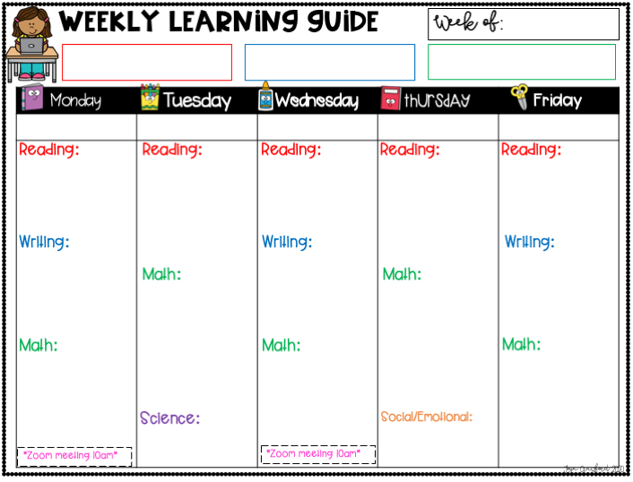
April 20-24th
Reading- I can compare and contrast two types of weather AND two stories.
Writing- I can research and write about one type of weather.
Math- I can compare and order numbers.
Read for 20 min
Listen to Hey Ray read aloud
Watch Ms. Pilon’s oo, ew, ue mini lesson
Complete oo, ew, ue sort activity
Read for 20 min
iReady Reading- 20 minutes
Read a book on the weather you picked for writng on Epic!
Complete oo,ew,ue activity
Read for 20 min
Listen to A Year for Kiko read aloud
Complete oo,ew,ue activity
Read for 20 min
iReady Reading- 25 minutes
Read a book on the weather you pick for writing on Epic!
Complete compare and contrast two stories activity on SeeSaw
Read for 20 min
Listen to Watching the Weather read aloud
Complete compare and contrast different weather activity
Watch Ms. Breer’s mini lesson on informative writing
Pick a type of weather you would like to research
Find books on Epic! to read on weather topic
Begin Informative weather writing
Complete “Weather Type” informative writing plan on SeeSaw
Complete informative writing on weather- include topic sentence, 3-5 informative sentences, and closing statement
Complete comparing numbers activity on SeeSaw
Complete ordering numbers activity on SeeSaw
iReady Math- 15 min
Watch Mrs. Crawford’s mini lesson on SeeSaw
Complete video and attached activity lesson on SeeSaw
iReady Math- 15 min
Watch Mrs. Crawford’s mini lesson on ordering numbers
Complete attached activity lesson on SeeSaw
iReady Math- 15 min
Complete number of the day activity on SeeSaw
Complete Tornado in a Glass activity
Watch and discuss Video 12: Identifying Our Own Feeling video
Parent Lesson Guide

