Slide 1
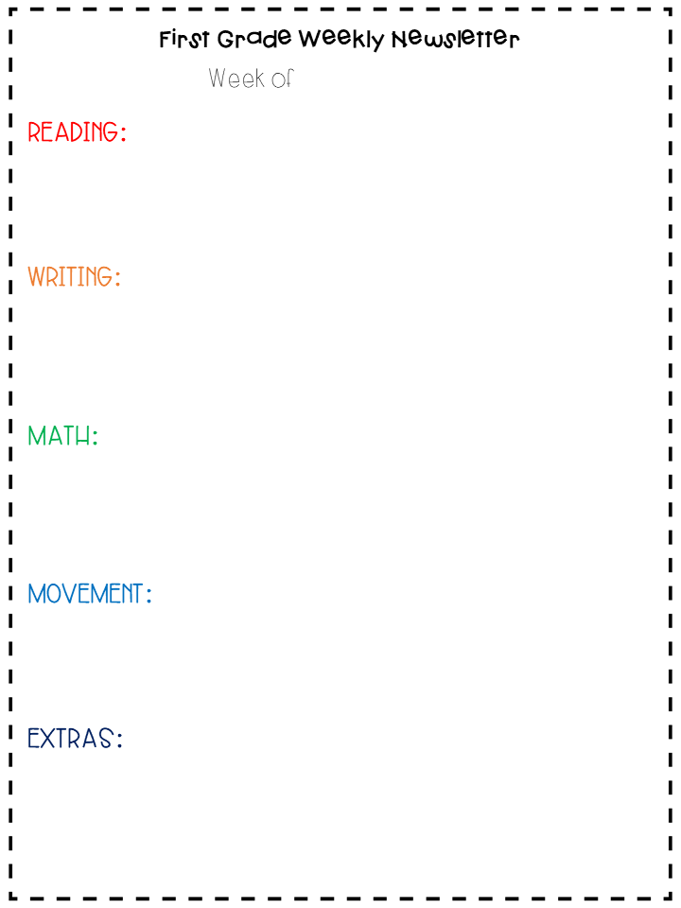
March 23rd – 27th, 2020
Read to self for 30 minutes a day (15min. at a time)
2 lessons in Iready reading
Pebble Go- read about frogs (username: epsfve password: pgo!)
Epic Books- login and read about frogs
Grab a pencil and paper and learn to Draw a frog. here
Get out your All About an Animal Journal: write about what you learned on frogs. Think about their habitat, diet, fun and interesting facts, and description (what it looks like…think about adjectives).
Seesaw- login to Seesaw and complete a telling time activity
Get out the Print and Play Place Value game packet- play the Fill a Row game with a partner.
Complete 2 lessons in Iready Math or play two games in Tang Math. Also, students can login to Prodigy.
Get outside and go for a walk.
Stuck inside? Try your favorite GoNoodle activity here
do some Cosmic Kids Yoga:
this weeks Theme is: Trolls here.
Learn to draw with Mo Williams. Mo Willems is the author of the Elephant and Piggie books and the Pigeon books. Click here.
Take a virtual fieldtrip to the Rainforest to learn more about frogs and other animals living there: click here
Don’t forget to check my website every few days.
New content is being added weekly! Miss Rew’s Website

